Slide 1
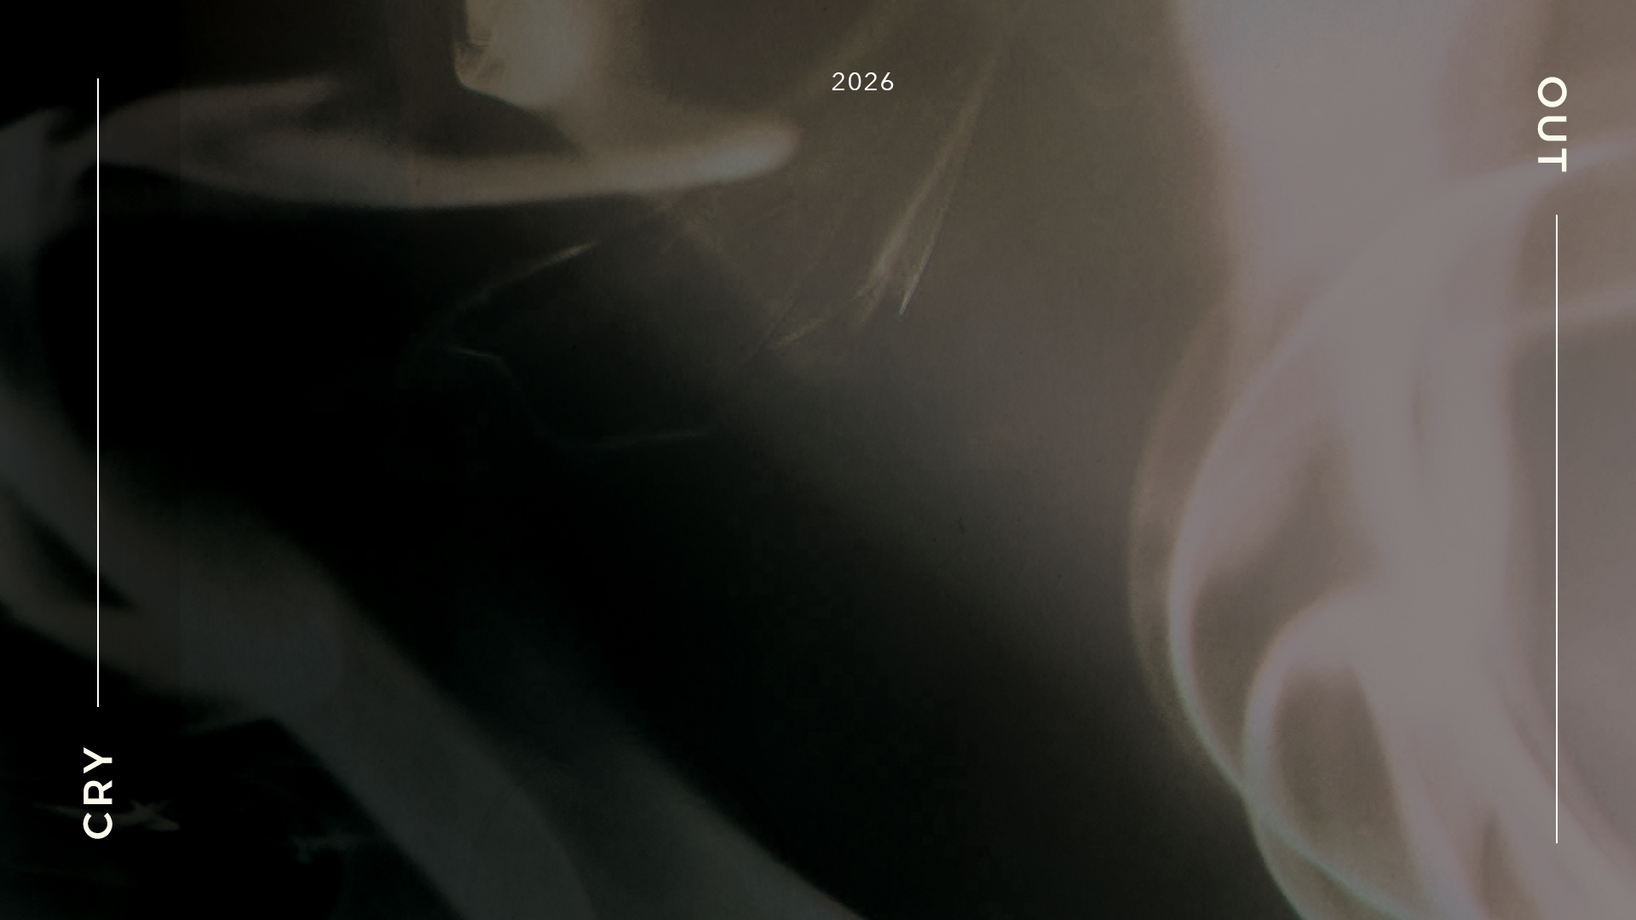
POSTEXILIC
PROPHETS
HAGGAI, ZECHARIAH & MALACHI

Slide 2

STUDY 4
“BEING CLEAN”
(Zechariah 3: 1-10)

Slide 3


WELCOME
Ice-breaker Activity: "Clean Slate"
We all sometimes wish we could have a "clean slate" in certain areas of our lives. This connects to our theme of spiritual cleansing in Zechariah 3.
Each person shares (in 1min or less): "If I could start fresh with a clean slate in one area of my life, it would be..."
Notes:
Facilitators’ Notes
Time allocated: 15 min
The objective of the activity is to build psychological safety in the group, and get group members to learn to listen to one another and grow in sharing something a bit vulnerable/authentic.

Slide 4
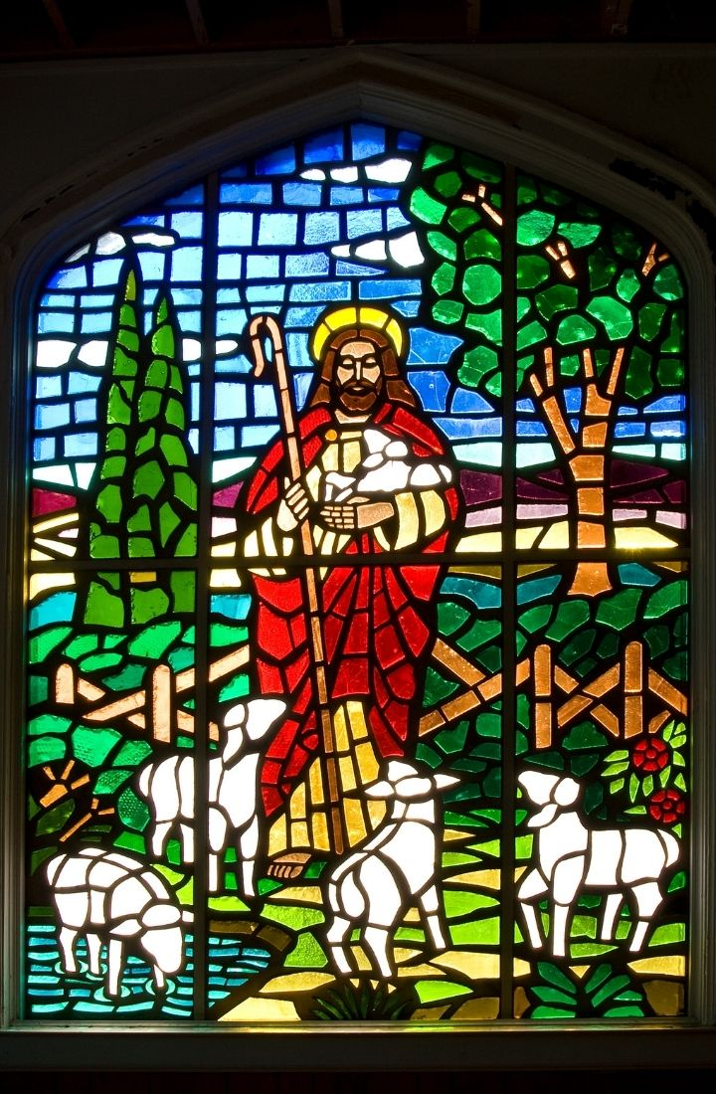
WORSHIP
Worship Jesus our great High Priest who lives to intercede for us and purify us from every sin.
Before the Throne of God Above (Kristyn Getty)
There Is A Fountain (Reawaken Hymns)
Jesus Paid It All (Fernando Ortega)
Refiner’s Fire (Brian Doerksen)
Notes:
Facilitators’ Notes
Time allocated: 15-20min
Tip: as the Spirit leads you, have a short time after worship for people to respond to God in prayer.

Slide 5
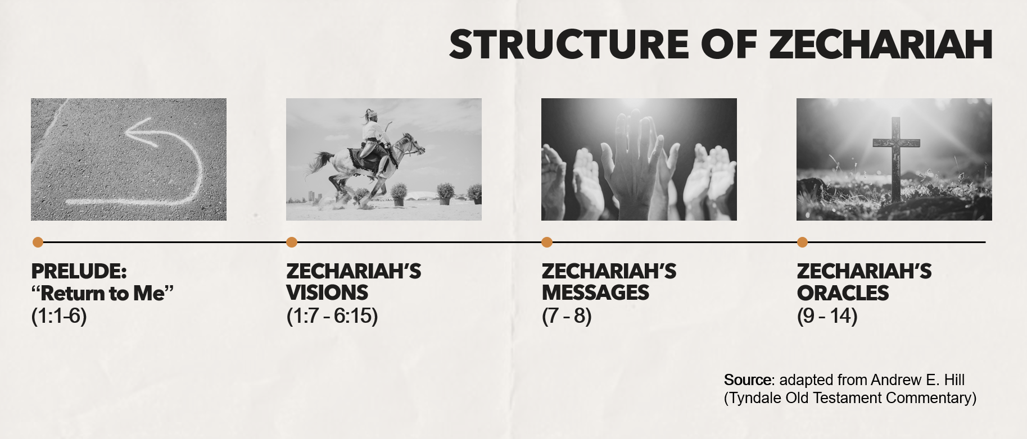
WORD
Notes:
Facilitators’ Notes:
This slide is used by the preachers for related sermons. For reference only.
​

Slide 6
Activity 1: Lectio Divina (Zechariah 3:1-10)
Get one member of the CG to read Zechariah 3:1-10 out loud, while the rest listen in silence.
Maintain silence for 2 minutes, reflecting on what stood out for you as you heard that reading. What is the Spirit of God drawing your attention to?
Another member of the CG can read Zechariah 3:1-10 out loud a second time.
Maintain silence for another 2 minutes, again listening to what the Spirit of God may be saying to you.
Notes:
Facilitators’ Notes
Time allocated: 10min
The point of lectio divina (divine reading) is to listen to what God’s Spirit has to say to us through God’s Word

Slide 7

The Context of Zechariah 3:1-10
When the word of the Lord came to Zechariah in the fall of 520 B.C., God’s people in Jerusalem would have been discouraged, for three reasons:
  The city walls lay in ruins. They were not protected against invaders.
  The temple was absent. Work on the temple had stalled for many years.
  The leadership of the province was in flux. Zerubbabel had only been appointed as governor months before.*
Zechariah 3 is the 4th of 8 night visions given to Zechariah, focusing on spiritual cleansing and restoration.
* Adapted from Gregory, Bryan R. Longing for God in an age of discouragement: the Gospel according to Zechariah. P & R Publ., 2010.
Notes:
Facilitators’ Notes
Time allocated: 2min
Get different members of the CG to read out. Do not get stuck too long on this. This is background context which will guide the interpretation of God’s Word.

Slide 8
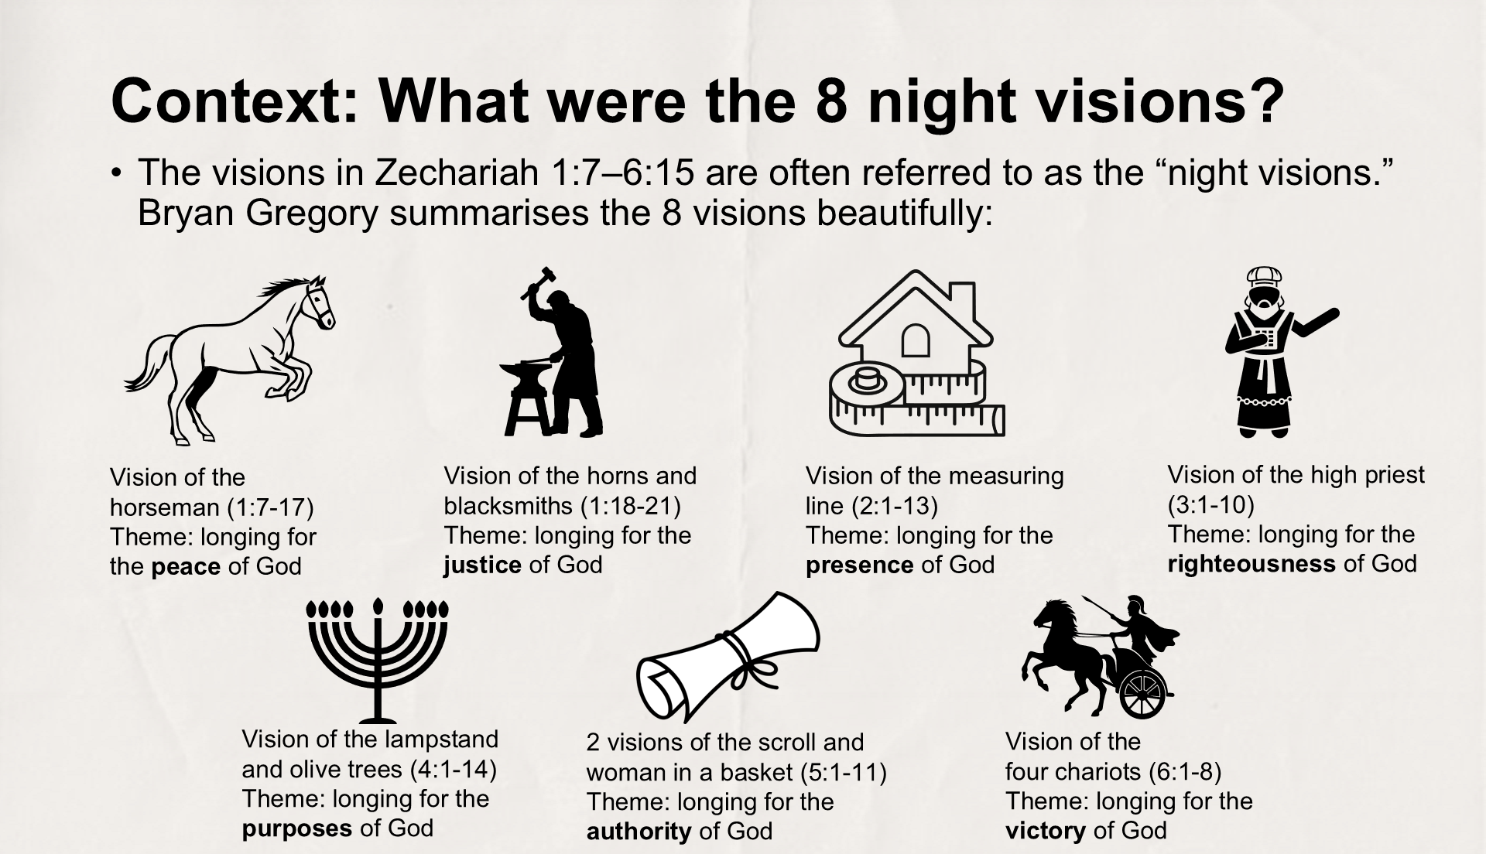
Notes:
Facilitators’ Notes:
This slide is used by the preachers during Sunday sermons. For reference only.

Slide 9
Context: Who was Joshua the High Priest?
We’ve encountered him before in Haggai 1:1-11.
His lineage can be traced through his father Jehozadak to the great priest Zadok and ultimately to Aaron, brother of Moses and first high priest of Israel.*
Joshua and Zerubbabel were key leaders (one priestly, one royal) in the second phase of the restoration of Jerusalem
Joshua represented both the spiritual leadership of God’s people and the spiritual condition of God’s people
If you want further background on Joshua, read Ezra 3
  * Mark J. Boda, The NIV Application Commentary (Grand Rapids, MI: Zondervan Publishing House, 2004), 250.
Notes:
Facilitators’ Notes
Time allocated: 2min
Get different members of the CG to read out. Do not get stuck too long on this. This is background context which will guide the interpretation of God’s Word.

Slide 10
Read Zechariah 3:1-5 and answer the following questions
Activity 2: Read & Discuss
From Zechariah 3:1, what do you notice about where Satan is standing and what he is doing?
From Zechariah 3:2, how does the LORD respond to the actions of Satan?
What do Joshua’s filthy garments symbolize (Zechariah 3:3)? What is the significance of him receiving clean clothes (Zechariah 3:5)?
Notes:
Facilitators’ Notes
Time allocated: 15min
Answers are meant to be short, and mostly found directly in the text itself
Try to give CG members (especially those who are more shy) an opportunity to answer
If CG members want to research and bring up additional historical and cultural context this should be welcomed, but there is no need to.

Slide 11
Question 1 Discussion Notes
Interesting fact: Zech 3:1 in Hebrew (the original language) Satan is not a proper name. It is literally “the satan”, which means “the enemy”
“the satan” or enemy is standing at the right hand of the angel of the LORD, a position of authority, making him a “first officer in the heavenly court”*
This adversary is something like a prosecuting lawyer, who brings an accusation and seeks a guilty verdict
Why this matters: do we sometimes feel weighed down by the accusation of Satan, the enemy of our souls?
*Andrew E. Hill, , ed. David G. Firth, vol. 28, Tyndale Old Testament Commentaries (Nottingham, England: Inter-Varsity Press, 2012), 148.
Notes:
Facilitators’ Notes
Do not show this to the CG if there is no need to. This is not the “model” answer.
You can show this slide when the CG is stuck and unable to proceed.
Don’t show it too soon because that will kill all thinking and discussion.

Slide 12
Question 2 Discussion Notes
The LORD rebukes the accusing enemy (the satan). This enemy could have been accusing Joshua for being unworthy of being God’s high priest
In the rebuke, God refers to Himself as “The LORD who has chosen Jerusalem”, and refers to Joshua as “a brand (burning stick) plucked from the fire”
The significance of this: what nullifies the accusation against Joshua is that God has sovereignly and graciously chosen Joshua and the whole of Israel – this choice was NOT because they had done anything to deserve it
Why this matters: when we feel condemned, let’s remember that because God has graciously chosen us, in Christ we are freed from condemnation (Romans 8:1)
Notes:
Facilitators’ Notes
Do not show this to the CG if there is no need to. This is not the “model” answer.
You can show this slide when the CG is stuck and unable to proceed.
Don’t show it too soon because that will kill all thinking and discussion.

Slide 13
Question 3 Discussion Notes
Joshua’s filthy garments are equated with his sin (Zech 3:4) – both his own sin and the sin of the people of God. The word translated “filthy” is closely related to two Hebrew nouns for human excrement and vomit*
The “pure vestments” (Zech 3:4) Joshua received are the fine clothes that the high priest would wear
This is significant because God has cleansed Joshua and installed him as a priest in Joshua temple. Through Joshua the priestly mediator God will be removing the guilt from His people!
Why this matters: we too can be cleansed and empowered by God!
  *Mark J. Boda, The NIV Application Commentary (Grand Rapids, MI: Zondervan Publishing House, 2004), 253.
Notes:
Facilitators’ Notes
Do not show this to the CG if there is no need to. This is not the “model” answer.
You can show this slide when the CG is stuck and unable to proceed.
Don’t show it too soon because that will kill all thinking and discussion.

Slide 14
Read Zechariah 3:6-10 and answer the following questions
Activity 3: Read & Discuss
In Zechariah 3:8, God refers to “my servant, the Branch”. Who does this represent and why is this important?
In Zechariah 3:9-10, there are two references to a particular “day”. What will God accomplish on this “day”, and why is this important for us?
Notes:
Facilitators’ Notes
Time allocated: 15min
Answers are meant to be short, and mostly found directly in the text itself
Try to give CG members (especially those who are more shy) an opportunity to answer
If CG members want to research and bring up additional historical and cultural context this should be welcomed, but there is no need to.

Slide 15
Question 4 Discussion Notes
Joshua himself is not the Branch. The Branch is a Davidic king of humble origins, who is associated with the coming kingdom of God with all its blessings.*
Both the terms servant and Branch are titles for the Messiah, God’s anointed one.
Why this matters: we are Christians under God’s New Covenant, and we now know that our hope rests in God’s Messiah, Jesus Christ. (The word “Christ” derives from the Greek word Christos. Christos is a translation of the Hebrew word Mashiach or Messiah.) The identity of the Messiah was not clear at all during the time of Zechariah.
  *Anthony R. Petterson, ed. David W. Baker and Gordon J. Wenham, vol. 25, Apollos Old Testament Commentary (Nottingham, England; Downers Grove, IL: Apollos; InterVarsity Press, 2015), 143.
Notes:
Facilitators’ Notes
Do not show this to the CG if there is no need to. This is not the “model” answer.
You can show this slide when the CG is stuck and unable to proceed.
Don’t show it too soon because that will kill all thinking and discussion.

Slide 16
Question 5 Discussion Notes
The phrase “in that day” is shorthand in the Old Testament prophets for the “Day of the Lord” - the eschatological Day where God will judge the wicked and vindicate the righteous
On that day, sin will be removed completely (Zechariah 3:9)
  This alludes to how the high priest represents the people and makes atonement for their sins through the Day of Atonement (Leviticus 16)
  But it also looks forward to a day when sin is removed permanently, making the Day of Atonement obsolete
That day will bring about new prosperity for the community of God’s people – that’s what the vine and fig tree represent (Zechariah 3:10)
Notes:
Facilitators’ Notes
Do not show this to the CG if there is no need to. This is not the “model” answer.
You can show this slide when the CG is stuck and unable to proceed.
Don’t show it too soon because that will kill all thinking and discussion.

Slide 17
Question 5 Discussion Notes (cont’d)
Why this matters: how are we living, in the light of God’s day of judgment, when we will all be called to account?
Notes:
Facilitators’ Notes
Do not show this to the CG if there is no need to. This is not the “model” answer.
You can show this slide when the CG is stuck and unable to proceed.
Don’t show it too soon because that will kill all thinking and discussion.

Slide 18
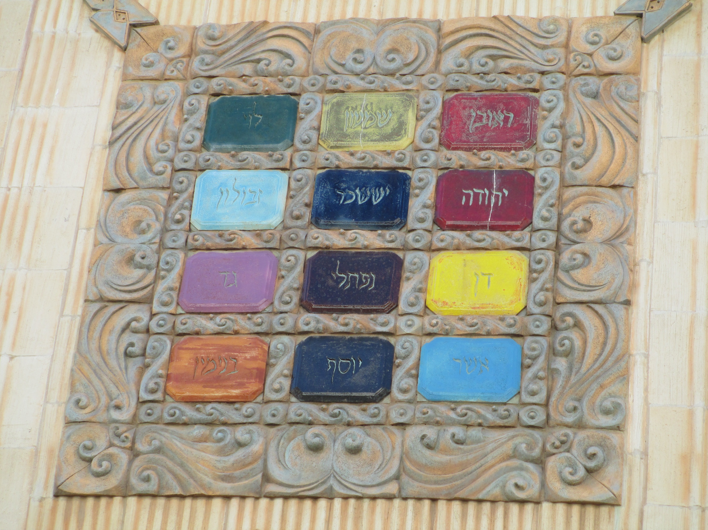
Exegetical Insight: What is the “stone with seven eyes”?
Scholars do not agree what the “stone with seven eyes” refers to. There are some possibilities, including:
  the letters engraved on the golden plate attached to the high priest’s turban (Ex. 28:36–38)
  the stones on the high priest’s breastplate/ephod complex (Ex. 28:16–28)*
In all these possibilities, the stone symbolizes how the high priest represents and bears the guilt of God’s people.
  Ceramic replica of the
  High Priest’s breastplate
  Source: wikimedia.org
  * Mark J. Boda, , The NIV Application Commentary (Grand Rapids, MI: Zondervan Publishing House, 2004), 258.
Notes:
Facilitators’ Notes
Time allocated: 15min
Answers are meant to be short, and mostly found directly in the text itself
Try to give CG members (especially those who are more shy) an opportunity to answer
If CG members want to research and bring up additional historical and cultural context this should be welcomed, but there is no need to.

Slide 19
Reflect, Share and Pray for one another
Condemnation: Are there areas of your life where you are weighed down by guilt and regret and feel defeated by sin (v.1)? Confess these to one another, and to God.
Cleansing: Pray for one another that our hearts may be purified and set free from the filthy garments of sin. (v.4)
Do not rush through this time of prayer. Give yourselves and one another the space that you need to bring your lives before God.
Notes:
Facilitators’ Notes
Time allocated: 20min
Choose one or more of the 4 areas
Pray for one another in your sub-groups / accountability groups – turning the sharing heavenward to God in prayer.

Slide 20
Next Steps (for personal reflection and action)
Might GOD be leading you to take the following steps in obedience to Him:
Conviction: Is God calling you to obey and serve Him, just as He called and empowered Joshua the high priest (v.7)?
Compassion: Are there non-Christian family members, friends, and colleagues that you know who need the LORD to cleanse and heal and save them? Pray for them by name and make concrete plans to reach out to them.
Notes:
Facilitators’ Notes
Time allocated: 20min
Choose one or more of the 4 areas
Pray for one another in your sub-groups / accountability groups – turning the sharing heavenward to God in prayer.

Slide 21
Additional Resources for Further Study
Gregory, Bryan R. Longing for God in an age of discouragement: the Gospel according to Zechariah. P & R Publ., 2010.
Anthony R. Petterson, ed. David W. Baker and Gordon J. Wenham, vol. 25, Apollos Old Testament Commentary (Nottingham, England; Downers Grove, IL: Apollos; InterVarsity Press, 2015)
Andrew E. Hill, ed. David G. Firth, vol. 28, Tyndale Old Testament Commentaries (Nottingham, England: Inter-Varsity Press, 2012)
Mark J. Boda, The NIV Application Commentary (Grand Rapids, MI: Zondervan Publishing House, 2004)
Notes:
Facilitators’ Notes
Share only to those who are keen.

