Slide 1

POSTEXILIC
PROPHETS
HAGGAI, ZECHARIAH & MALACHI

Slide 2
STUDY 2
“BE STRONG & PERSEVERE”
(Haggai 2: 1-9)

Slide 3


WELCOME
Ice-breaker Activity: "Perseverance matters..."
What is one thing or area in life that you find require perseverance?
Share about an incident/ instance when you were discouraged but your perseverance paid off.
Notes:
Facilitators’ Notes
Time allocated: 10min
This is meant to be a light-hearted sharing – to give an insight into people's lives and what they think is worth persevering in.
Don't need everyone in the group to share. Can pick a few and prepare them ahead to come prepared to share

Slide 4

WORSHIP
Worship our faithful God who works all things for His Glory and our Good.
Great is Thy Faithfulness (Reawaken Hymns)
His Glory & My Good (CityAlight)
Way Maker (Leeland)
Battle Belongs (Phil Wickham)
Notes:
Facilitators’ Notes​
​
Time allocated: 15-20min​
Tip: as the Spirit leads you, have a short time after worship for people to respond to God in prayer.

Slide 5
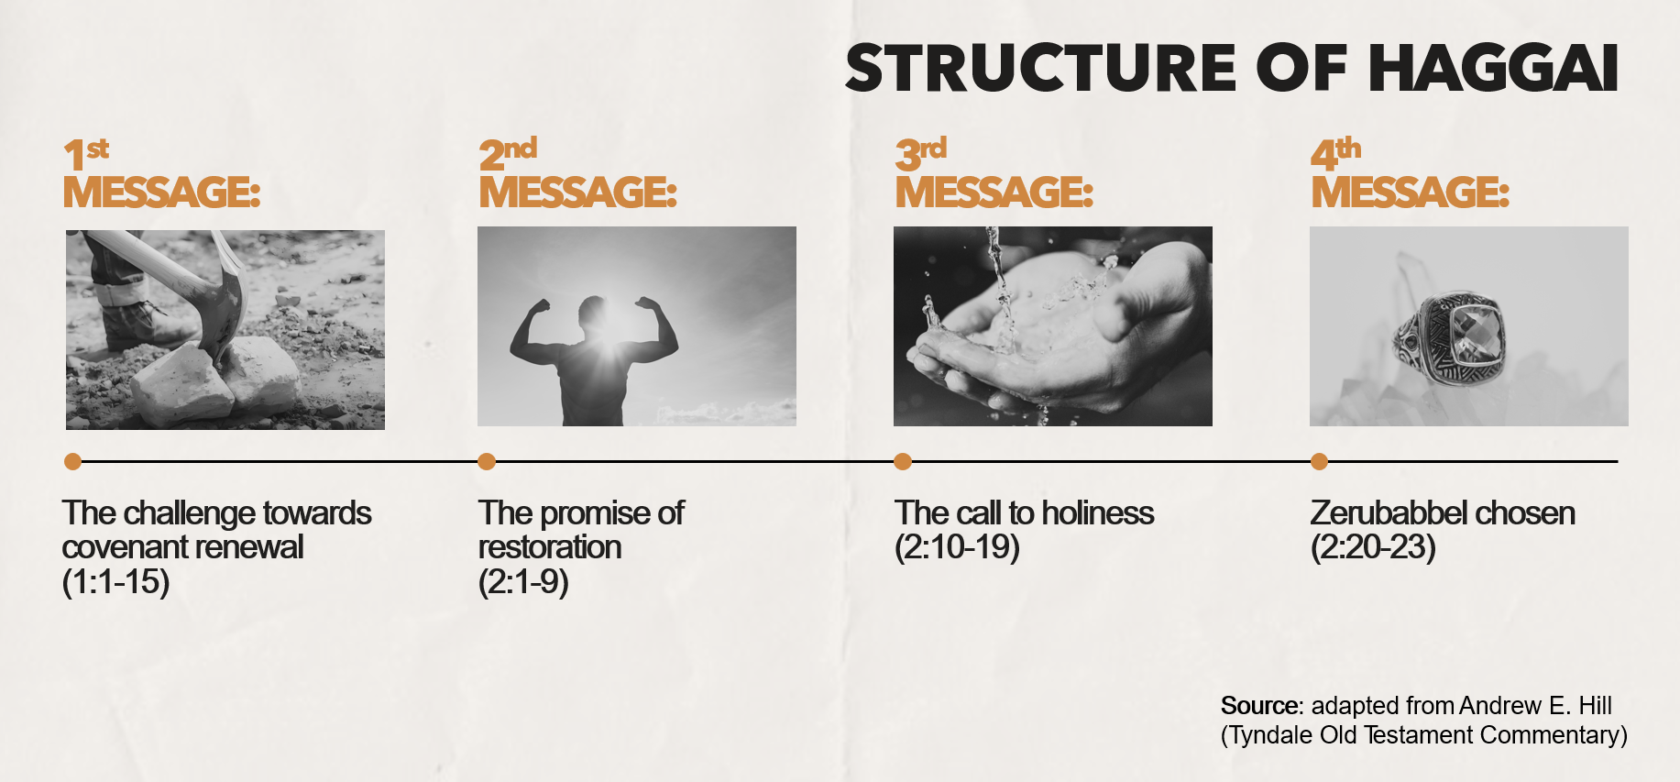
WORD
Notes:
Facilitators’ Notes:
This slide is used by the preachers for related sermons. For reference only.

Slide 6
Activity 1: Read & Discuss
Read Haggai 2:1-3 and discuss the following questions.
Why do you think that the returned exiles in Jerusalem were feeling discouraged as they started the temple rebuilding project? (read v.3 closely, and look at Ezra 3:12-13 for more background context)
Try to imagine yourself in their shoes. How do you think you would have felt if you were one of them?
Notes:
Facilitators’ Notes
Time allocated: 15min
Answers are meant to be short, and mostly found directly in the text itself
Try to give CG members (especially those who are more shy) an opportunity to answer
If CG members want to research and bring up additional historical and cultural context this should be welcomed, but there is no need to.

Slide 7
Question 1 Discussion Notes
v.1 tells us that they were just one month into the rebuilding journey. The work would have been tough, clearing the rubble and so on.
v.3a says: “who is left among you who saw the house in its former glory?” The older generation would have remembered the magnificence of Solomon’s temple before the Babylonian exile
v.3b says: “How do you see it now? Is it not as nothing in your eyes?” ‘It’ refers to the new temple that they were rebuilding - a pale shadow of what Solomon’s temple was like before
Notes:
Facilitators’ Notes
Do not show this to the CG if there is no need to. This is not the “model” answer.
You can show this slide only when the CG is completely stuck and unable to proceed.
Don’t show it too soon because that will kill all thinking and discussion.

Slide 8
Question 1 Discussion Notes (Cont’d)
Ezra 3:12-13 talks about how the older ones wept when they saw the foundation of the new temple being laid.
The people may have felt discouraged in the rebuilding journey because the work of their hands seemed so insignificant and did not meet their own internal expectations.
Notes:
Facilitators’ Notes
Do not show this to the CG if there is no need to. This is not the “model” answer.
You can show this slide only when the CG is completely stuck and unable to proceed.
Don’t show it too soon because that will kill all thinking and discussion.

Slide 9

Exegetical Insight 1: What was “this house in its former glory”?
This refers to Solomon’s temple (see picture in following slide).
Details of the architecture of the temple are in 1 Kings 6-7 and 2 Chronicles 3-4.
Notes:
Facilitators’ Notes
Time allocated: 3min (this slide and next)
Go through this briefly, read out or get someone to read
This is meant to provide a deeper understanding of the text and pique people’s interest to know more
Can skip if short on time

Slide 10
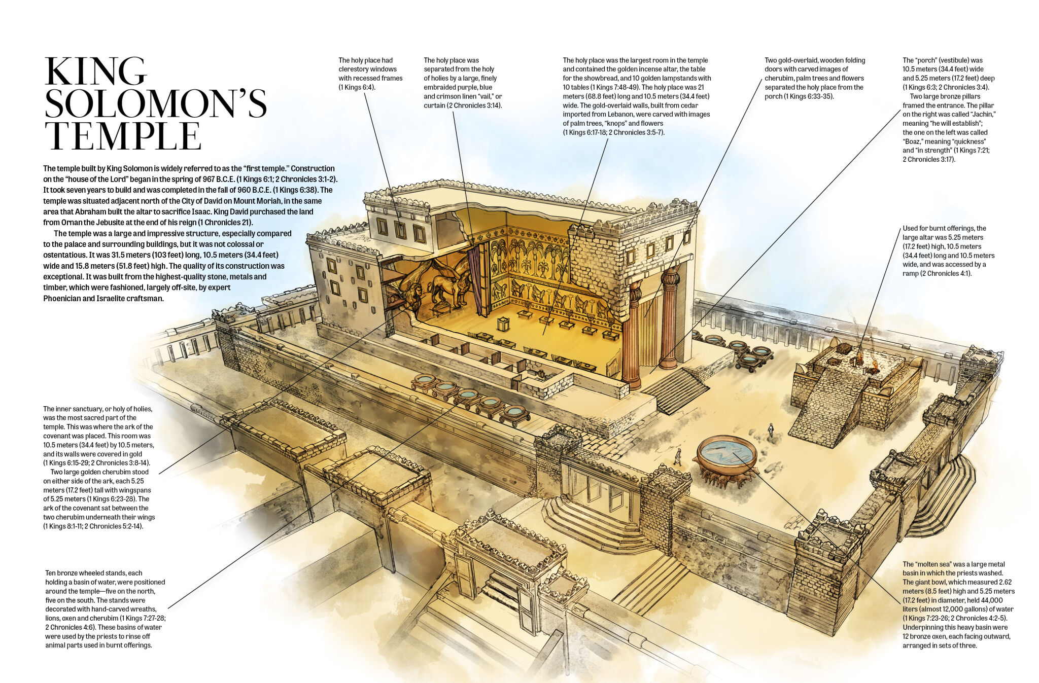
Source: armstronginstitute.org

Slide 11
Exegetical Insight 1: What was “this house in its former glory”?
Some highlights of Solomon’s Temple:
It was built with finely dressed stone (pre-cut so no hammering was heard on-site) (1 Kings 6:7).
Cedar panels from Lebanon were overlaid with pure gold (1 Kings 6:15, 20-22).
Every surface inside was covered in gold: walls, floors, ceilings, and even the altar (1 Kings 6:20-22, 30)
Engravings of cherubim, palm trees, and flowers adorned the walls and doors (1 Kings 6:29, 32, 35)
Notes:
Facilitators’ Notes
Time allocated: 3min (this slide and next)
Go through this briefly, read out or get someone to read
This is meant to provide a deeper understanding of the text and pique people’s interest to know more
Can skip if short on time

Slide 12
Exegetical Insight 1: What was “this house in its former glory”? (Cont’d)
The temple was built in 7 years (1 Kings 6:37-38) by 30,000 laborers and 3,300 foremen (1 Kings 5:13-16)
Solomon’s temple was built at the height of the might and wealth of the Davidic kingdom. That’s why there was absolutely no way the new temple that the returned exiles were trying to build could match up!
Notes:
Facilitators’ Notes
Time allocated: 3min (this slide and next)
Go through this briefly, read out or get someone to read
This is meant to provide a deeper understanding of the text and pique people’s interest to know more
Can skip if short on time

Slide 13
Activity 2: Read & Discuss
Read Haggai 2:4-5 and discuss the following questions
What are the main imperatives (commands) in verses 4-5?
What are the reasons that God gives His people to obey his commands (focus especially on v.5)?
Notes:
Facilitators’ Notes
Time allocated: 15min
Answers are meant to be short, and mostly found directly in the text itself
Try to give CG members (especially those who are more shy) an opportunity to answer
If CG members want to research and bring up additional historical and cultural context this should be welcomed, but there is no need to.

Slide 14
Questions 3 and 4 Discussion Notes
The two imperatives (commands) are
  “be strong”” is used 3 times: to Zerubbabel, Joshua, and the people
  “work” (on the rebuilding of the temple)
God gives these reasons for the people to obey His commands:
  God is with us – His abiding presence!
  God remains faithful to His covenant – His unfailing promise!
Why this matters: God’s commands are not harsh impositions on us, but gracious invitations to experience His saving and transforming power! Doesn’t that motivate obedience?
Notes:
Facilitators’ Notes
Do not show this to the CG if there is no need to. This is not the “model” answer.
You can show this slide only when the CG is completely stuck and unable to proceed.
Don’t show it too soon because that will kill all thinking and discussion.

Slide 15
A Quote to Chew On
Although the temple was the designated place of God’s manifest presence on earth, those who rise to the challenge of building the temple are immediately promised God’s presence through the words: "I am with you." It is this promise that becomes a springboard for encouraging the people to continue rebuilding.
- Mark J. Boda, The NIV Application Commentary (Grand Rapids, MI: Zondervan Publishing House, 2004), 128
Notes:
Facilitators’ Notes
Time allocated: 2min
You can get someone to read this out.
The theological truth that the quote points to is the significance of the work of rebuilding the temple (a representation of God’s presence with us), but that God’s presence is FAR bigger and greater than the temple. It can be experienced even without the temple!

Slide 16
Activity 3: Read & Discuss
Read Haggai 2:6-9 and discuss the following question:
We have confidence to work for God because ultimately we know God is at work! In this passage, what are the actions that God promises to carry out? What do you think is the meaning and significance of those actions?
Notes:
Facilitators’ Notes
Time allocated: 20min
CG members will likely be able to identify the actions through the verbs in the text
But it may be harder for them to understand, on the basis of the English text alone, what is the meaning of these actions e.g. what does it mean for God to “shake the heavens and the earth”?
It’s ok if CG members are not sure of the answer. See if they can infer (make educated guesses) based on the text before “revealing the answer”, because this will help them to interact with the text.

Slide 17
Question 5 Discussion Notes
The actions of God are conveyed in the ESV through four “I will” statements:
“I will shake the heavens and the earth …” (v.6)
  Significance: This speaks of God's sovereign power over all creation that will be demonstrated when he establishes His Kingdom on earth.*
  God was reassuring the returned exiles that He is Lord of creation, both visible and invisible.
  *Anthony R. Petterson, Haggai, Zechariah & Malachi, ed. David W. Baker and Gordon J. Wenham, vol. 25, Apollos Old Testament Commentary (Nottingham, England; Downers Grove, IL: Apollos; InterVarsity Press, 2015), 70.
Notes:
Facilitators’ Notes
Show this slide and go through only after the CG has discussed

Slide 18
Question 5 Discussion Notes (cont’d)
“I will shake all nations” (v.7)
  Significance: God will assert His authority over all the nations and world governments, and over the course of human history. This is important because the returned exiles were fearful (v.5) of all the powerful nations that surrounded them.
  God was reassuring them that He ultimately rules over all human authorities and powers.
Notes:
Facilitators’ Notes
Show this slide and go through only after the CG has discussed

Slide 19
Question 5 Discussion Notes (cont’d)
“I will fill this house with glory” (v.8)
  Significance: Recall that the returned exiles had mourned that the former glory of the old temple was far greater than the present (v.3) God promises to reverse this, because in the future He will fill His temple with so much glory that “the latter glory of this house shall be greater than the former” (v.9)!
  God was reassuring them that He would bless His people with His glorious presence (see Zechariah 2:5).
Notes:
Facilitators’ Notes
Show this slide and go through only after the CG has discussed

Slide 20
Question 5 Discussion Notes (cont’d)
“I will give peace” (v.9)
  Significance: God’s peace (shalom) refers not just to security and the absence of armed conflict, which the returned exiles would have wanted so dearly, but also wholeness, well-being and prosperity.*
  God was reassuring them that He would restore and repair their broken lives and broken nation!
*Andrew E. Hill, , ed. David G. Firth, vol. 28, Tyndale Old Testament Commentaries (Nottingham, England: Inter-Varsity Press, 2012), 8283.
Notes:
Facilitators’ Notes
Show this slide and go through only after the CG has discussed

Slide 21
Reflect and Share
Are there situations in your life where you feel disappointed and dismayed, even though you are trying to do what God has called you to do? (v.3)
What are one or two areas in your personal life, family, workplace, and ministry that you are asking God to transform with His glorious presence and with His peace? (v.9)
Notes:
Facilitators’ Notes
Time allocated: 15min
May want to do this in sub groups to give people more time to share
For question 1, focus not just on challenging people to step up in faith to serve, but also affirming people as they share how they have already been serving. For some it is not a call to do new things but an encouragement to be faithful in what they are already doing.
Question 2 is linked to the earlier reflection question on priorities. Some may feel too shy to share, or not have the language for it. As leaders we can model authenticity by sharing some of our struggles in obedience and surrender to the Lord, while also talking about how we have moved forward in our own journey.

Slide 22
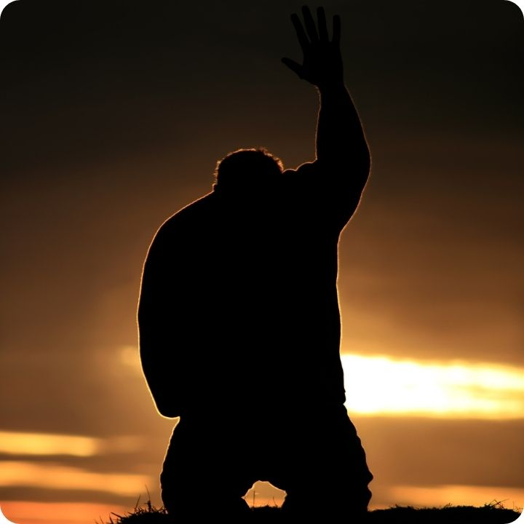
Worship & Prayer based on the Scriptures
Worship the Lord and receive His grace and strength:
  Everlasting God
  Raise a Hallelujah
Notes:
Facilitators’ Notes
Time allocated: 20min
The songs are suggested, in line with the theme. Feel free to choose your own.

Slide 23
Worship & Prayer based on the Scriptures
2. Spend extended time praying for and with one another:
  for the Spirit of God to renew courage within our hearts to do God’s will (v.4)
  for ungodly fears to be surrendered and silenced (v.5)
  for the peace (shalom) of God to fill our families and workplaces (v.9), that what is broken may be restored
  for non-Christians that we know to be drawn to the glory of God (v.9)
Notes:
Facilitators’ Notes
Time allocated: 20min
The songs are suggested, in line with the theme. Feel free to choose your own.

Slide 24
Additional Resources for Further Study
Anthony R. Petterson, ed. David W. Baker and Gordon J. Wenham, vol. 25, Apollos Old Testament Commentary (Nottingham, England; Downers Grove, IL: Apollos; InterVarsity Press, 2015)
Andrew E. Hill, , ed. David G. Firth, vol. 28, Tyndale Old Testament Commentaries (Nottingham, England: Inter-Varsity Press, 2012)
Mark J. Boda, , The NIV Application Commentary (Grand Rapids, MI: Zondervan Publishing House, 2004)
Notes:
Facilitators’ Notes
Share only to those who are keen.

