Slide 1

POSTEXILIC PROPHETS
HAGGAI, ZECHARIAH & MALACHI

Slide 2
STUDY 1
HAGGAI: INTRODUCTION & “BUILD GOD’S HOUSE!”
(Haggai 1:1-15)

Slide 3

NOTE TO ALL USERS
The post-exilic prophets (Haggai, Zechariah, and Malachi) speak to the generation that returned from the Babylonian Exile (586–538 B.C.).
The exile was the ultimate fulfilment of the prophets' warnings of judgment, while their return, initiated by the Persian King Cyrus's decree in 538 B.C., was the initial fulfilment of the prophets' promises of restoration.
As a pre-work, read Ezra 1-7 for background understanding of the commencement of the return, the oppositions encountered and the eventual completion of the second temple. The following timeline may help.

Slide 4
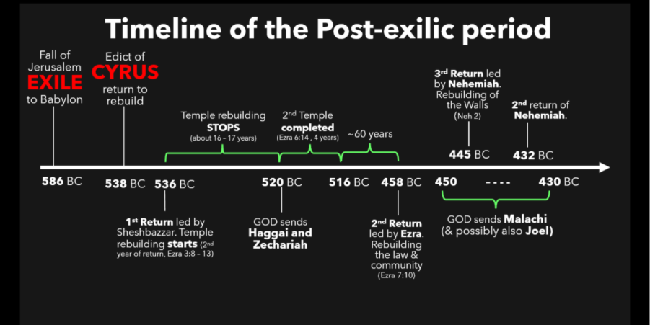

Slide 5
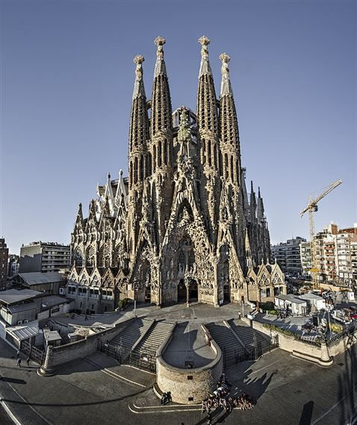
WELCOME
Ice-breaker Activity: “Unfinished..."
Can you recognize this famous unfinished building project?
What is one spiritual project God may have given you that is yet to be finished?
Photo credit: Pinterest
Notes:
Facilitators’ Notes:
Can read the following out to the CG if they are keen.
The Sagrada Família in Barcelona is one of the most famous unfinished buildings in the world. Designed by Antoni Gaudí, construction began in 1882, but due to various reasons, including the death of Gaudí in 1926, the project has faced numerous delays. Despite these challenges, the project continues to inspire and attract visitors from around the globe.
Get only one or two to share, just to break the ice. It’s ok if no one wants to share.

Slide 6

WORSHIP
As we worship the Lord God Almighty, may we catch a glimpse of His glory!
Glory (Hillsong)
A Thousand Hallelujahs (Brook Ligertwood)
Build my Life (Pat Barrett)
Make Room (The Church Will Sing)
Notes:
Facilitators’ Notes​
​
Time allocated: 15-20min​
Tip: as the Spirit leads you, have a short time after worship for people to respond to God in prayer.

Slide 7
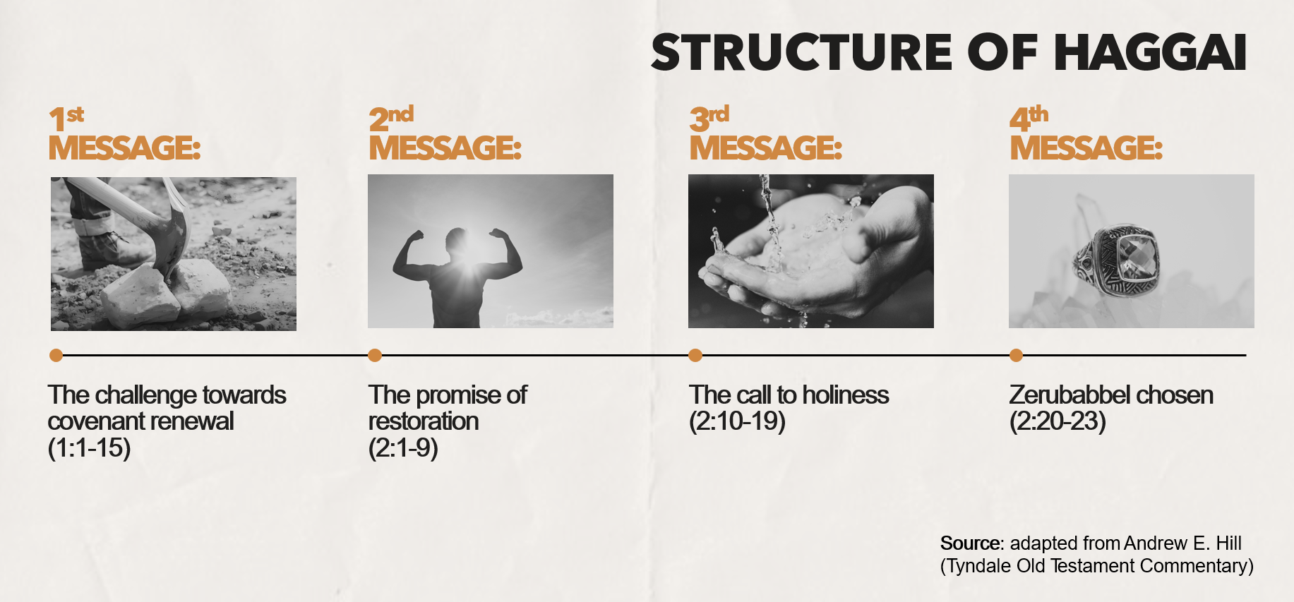
WORD
Notes:
Facilitators’ Notes:
This slide is used by the preachers for related sermons. For reference only.

Slide 8
Activity 1: Watch a Video
Let’s watch a short Bible Project video that provides a good introduction and summary of the context, structure and message of the book of Haggai.
After you have viewed it, discuss the following question:
1. What was the situation that God’s people in Judah were facing at the time of Haggai’s message?
Notes:
Facilitators’ Notes​
​
Time allocated: 10min​
This is meant to be a question to prime people’s attention so that they view the video attentively. It is not meant to get CG members to comprehensively describe the historical and cultural context of the remnant who had returned to Judah.​

Slide 9
Question 1 Discussion Notes
  Haggai’s message came in 520 BC, nearly 70 years after the exile.​
  The Persians allowed the return of any exiled Israelites who wanted to go back to Jerusalem, which still lay in ruins.​
  Under the leadership of Joshua (high priest) and Zerubbabel (an heir from the line of David) a group of exiles returned to rebuild the city and their lives.​
  The people would have been concerned about survival: livelihood and agriculture, hostility from neighbouring nations
Notes:
Facilitators’ Notes​
​
Do not show this to the CG if there is no need to. This is not the “model” answer.​
You can show this slide only when the CG is completely stuck and unable to proceed.​
Don’t show it too soon because that will kill all thinking and discussion.​

Slide 10
Activity 2: Read & Discuss
Read Haggai 1:1-11 and discuss the following questions
2. What was the people’s initial attitude to building the house of the LORD? (v.2)​
3. Why do you think the people had that attitude? (infer from v.4,9)​
4. What was life like for the people as a result of their reluctance to build God’s house? (v.6, 10-11) ​
Notes:
Facilitators’ Notes​
​
Time allocated: 20min​
Answers are meant to be short, and mostly found directly in the text itself​
Try to give CG members (especially those who are more shy) an opportunity to answer​
If CG members want to research and bring up additional historical and cultural context this should be welcomed, but there is no need to.​

Slide 11
Questions 2-4 Discussion Notes
The people were unwilling to build the house of the Lord and preferred to procrastinate.​ This was because they were preoccupied with building their own houses (v.9) i.e. they were concerned about their own survival.​
Commentator Mark Boda says they could have felt that they had insufficient financial resources to build God’s house, or that they were afraid of punishment by their Persian overlords.*
As a result of their reluctance, God called for drought on the land (v.11), and the people experienced material lack (v.6). ​
*Mark J. Boda, The NIV Application Commentary (Grand Rapids, MI: Zondervan Publishing House, 2004), 89.​ ​
Notes:
Facilitators’ Notes​
​Do not show this to the CG if there is no need to. This is not the “model” answer.​
You can show this slide only when the CG is completely stuck and unable to proceed.​
Don’t show it too soon because that will kill all thinking and discussion.

Slide 12


EXEGETICAL INSIGHT 1
What are “paneled houses”?
Do they look like this?
Paneled Houses?
Notes:
Facilitators’ Notes​
​Time allocated: 3min​
Go through this briefly, read out or get someone to read​
This is meant to provide a deeper understanding of the text and pique people’s interest to know more​
Can skip if short on time​

Slide 13
Exegetical Insight 1: What are “paneled houses”?​
  The phrase “paneled houses” is probably better understood in the sense of ‘roofed’ or ‘completed’ houses, in contrast to the LORD’s ‘unfinished’ house—lacking even a roof! *
  Thus the use of the term does not mean that the returned exiles were trying to build luxurious homes for themselves and thereby forgetting God’s house – they were poor and just trying to survive!​
  *Andrew E. Hill, , ed. David G. Firth, vol. 28, Tyndale Old Testament Commentaries (Nottingham, England: Inter-Varsity Press, 2012), 65.
Notes:
Facilitators’ Notes​
​
Time allocated: 3min​
Go through this briefly, read out or get someone to read​
This is meant to provide a deeper understanding of the text and pique people’s interest to know more​
Can skip if short on time​

Slide 14
Exegetical Insight 1: What are “paneled houses”?​
  Why this matters to us…
  Even if we think we are just “trying to survive” in life, and don’t have the luxury or buffer we want, we are still called to build God’s house and Kingdom (Matt 6:33, Luke 17:19).
Notes:
Facilitators’ Notes​
​
Time allocated: 3min​
Go through this briefly, read out or get someone to read​
This is meant to provide a deeper understanding of the text and pique people’s interest to know more​
Can skip if short on time​

Slide 15
Exegetical Insight 2: Why does God “punish”
the people for their disobedience?​​
  At first glance it seems harsh and transactional that God is punishing His people for not building His house, by causing a drought.​
  Commentator Anthony Petterson explains: There is Hebrew word play going on. The LORD's people have left the temple ‘desolate’ (ḥārēb, v.4,9),so the LORD has called for a ‘desolation’ (ḥōreb) or drought upon the land (v.11) to get their attention!*​
  *Anthony R. Petterson, , ed. David W. Baker and Gordon J. Wenham, vol. 25, Apollos Old Testament Commentary(Nottingham, England; Downers Grove, IL: Apollos; InterVarsity Press, 2015), 58.
Notes:
Facilitators’ Notes​
​
Time allocated: 4min (for this slide and next)​
Go through this briefly, read out or get someone to read​
This is meant to provide a deeper understanding of the text and pique people’s interest to know more​

Slide 16
Exegetical Insight 2: Why does God “punish”
the people for their disobedience?​​
  But this is not tit-for-tat transactional punishment. This is because we must understand all of this through the lens of the Mosaic covenant, a relational covenant which included covenant blessings and curses. God put the land under His curse because the people were unfaithful to the covenant (see Deuteronomy 28:22-24).​
  The Mosaic covenant was a covenant of grace, centered on relationship, because God had chosen Israel to be His treasured possession, and given them the privilege to walk in His ways (Exodus19:4-6).
Notes:
13

Slide 17
Exegetical Insight 2: Why does God “punish”
the people for their disobedience?​​
Why this matters to us…
The covenant God establishes with us is RELATIONAL, not TRANSACTIONAL.
We don’t obey God to earn the blessings we want or to avoid punishment. For instance, we can’t say, “Lord if I build your house you must prosper me and give me a high-paying job!”
We obey as a response of faith to God’s gracious love.
Notes:
14

Slide 18
Activity 3: Pause & Reflect
  “Consider your ways…”
  The phrase “consider your ways” (Haggai 1:5,7, ESV) can also be understood as “give careful thought” or “reflect deeply from the heart”.​
  Ask yourself this soul-searching question: In what ways might we be placing our priorities over God’s priorities?
Notes:
Facilitators’ Notes​
​
Time allocated: 5min​
This is a pause in the CG word study for people to engage at the personal level with the text being studied, for the message to travel from the head to the heart. It is also a pause to be quiet, a change of pace from all the talking.​
People can use their physical journals or journal their reflection on their phones.​
There is no need to share at this point. They can share and pray at the end.​

Slide 19
Activity 4: Read & Discuss
Read Haggai 1:12-15 and discuss the following questions:
5. How did the people respond to God’s command after they had heard Haggai’s message? (v.12)​
6. What did God say and do to assure and strengthen the people? (v.13-14)
Notes:
Facilitators’ Notes​
​
Time allocated: 15min​
Answers are meant to be short, and mostly found directly in the text itself​
Try to give CG members (especially those who are more shy) an opportunity to answer​
If CG members want to research and bring up additional historical and cultural context this should be welcomed, but there is no need to.

Slide 20
Question 5 Discussion Notes
The people’s response to God was remarkable:​
  The leaders and “all the remnant of the people” obeyed (v.12) –there was great unity!​
  They obeyed the voice of the Lord their God (v.12) – there was great humility!
  ​
  They feared the Lord (v.12) – there was great reverence! (This was not about being scared of divine punishment.)​
Notes:
Facilitators’ Notes​
​
Do not show this to the CG if there is no need to. This is not the “model” answer.​
You can show this slide only when the CG is completely stuck and unable to proceed.​
Don’t show it too soon because that will kill all thinking and discussion.​

Slide 21
Question 6 Discussion Notes
In response, God assured and strengthened the people by:​
  Declaring that He was with them (v.13)​
  Stirring up their spirit (v.14) – in Hebrew it means to “awaken or set in motion”. God was reviving His people to fulfil His purpose!
Notes:
Facilitators’ Notes​
​
Do not show this to the CG if there is no need to. This is not the “model” answer.​
You can show this slide only when the CG is completely stuck and unable to proceed.​
Don’t show it too soon because that will kill all thinking and discussion.​

Slide 22
Exegetical Insight 3: What does the title
“The LORD of hosts” mean?​​​
  The title “The LORD of hosts” (yhwh ṣĕbā’ôt) occurs 14 times in Haggai, and is repeated 5x in today’s passage (v.2,5,7,9,14)​
  The word “hosts” literally means armies, and refers to the armies of heaven​
  Thus the title speaks of the tremendous might and power of God​
Notes:
Facilitators’ Notes​
​
Time allocated: 3min​
Go through this briefly, read out or get someone to read​
This is meant to provide a deeper understanding of the text and pique people’s interest to know more​
Can skip if short on time​

Slide 23
Exegetical Insight 3: What does the title
“The LORD of hosts” mean?​​​
  Why this matters to us…
  It is the God of tremendous might who calls us to join His work of building His house. His might alone will accomplish the work and make us sufficient for the task He has called us!
Notes:
Facilitators’ Notes​
​
Time allocated: 3min​
Go through this briefly, read out or get someone to read​
This is meant to provide a deeper understanding of the text and pique people’s interest to know more​
Can skip if short on time​

Slide 24
Reflect & Share
  How is God calling you to build His house today? (v.8)​
  2. What might be holding you back from full obedience to God? (v.12)​
Notes:
Facilitators’ Notes​
Time allocated: 15min

Slide 25
Pray for One Another
  That we would experience the close and abiding presence of the Lord in every season of life. (v.13)​
  That the Lord would stir up our spirits and give us zeal to build His house, living for something larger than ourselves. (v.14)​
Notes:
Facilitators’ Notes​
Time allocated: 10min

Slide 26
Additional Resources
  Anthony R. Petterson, ed. David W. Baker and Gordon J. Wenham,vol. 25, Apollos Old Testament Commentary (Nottingham,England; Downers Grove, IL: Apollos; InterVarsity Press, 2015)​
  Andrew E. Hill, , ed. David G. Firth, vol. 28, Tyndale Old TestamentCommentaries (Nottingham, England: Inter-Varsity Press, 2012)​
  Mark J. Boda, , The NIV Application Commentary (Grand Rapids,MI: Zondervan Publishing House, 2004)
Notes:
Facilitators’ Notes
Share only to those who are keen.

