Slide 1


POSTEXILIC PROPHETS
HAGGAI, ZECHARIAH & MALACHI

Slide 2
STUDY 10
REVIEW: Remembering And Renewing
- What Has God Deposited In Your Heart This Year?

Slide 3



WORSHIP
Come before Him in thanksgiving and praise!
Great are you Lord (All Sons & Daughters)​
The Heart of Worship (Matt Redman)
King of Kings (Hillsong)
Notes:
Facilitator Notes​
​
Time allocated: 15-20min​
Tip: as the Spirit leads you, have a short time after worship for people to respond to God in prayer.

Slide 4


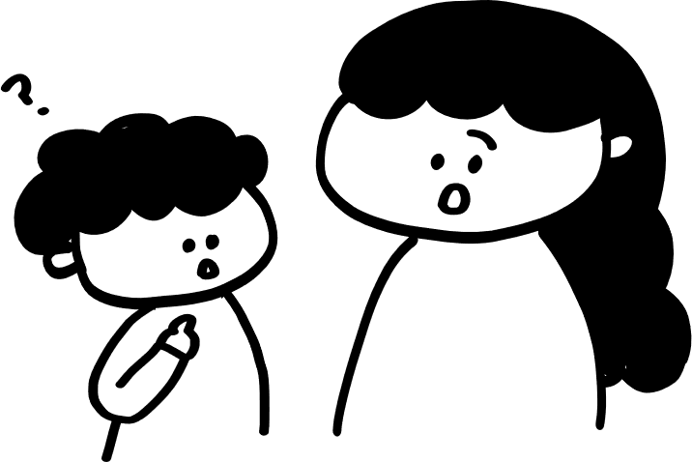
WORD
Activity 1: WHO SAY ONE?
For each of the following 5 quotes, identify which prophet said it: Haggai, Zechariah or Malachi :)
After each quote there will be 1 trivia question based on the quote.
The prizes are … eternal rewards in heaven! (Or, you can buy for yourselves.)
Notes:
Facilitator Notes​
​
Time allocated: 15min​
Fun activity meant to review key verses

Slide 5

“I have loved you,” says the Lord. But you say, “How have you loved us?”
QUOTE 1 – who say one?

Slide 6
“I have loved you,” says the Lord. But you say, “How have you loved us?”
MALACHI say one! (1:2a)

Slide 7
“I have loved you,” says the Lord. But you say, “How have you loved us?”
Anyone remember why Malachi said this to God’s people?
Notes:
This is the first of the 6 disputations in the book of Malachi.
The people doubted and disputed God’s goodness and love.

Slide 8
And the angel said to those who were standing before him, “Remove the filthy garments from him.”
QUOTE 2 -who say one?

Slide 9
And the angel said to those who were standing before him, “Remove the filthy garments from him.”
ZECHARIAH say one! (3:4)

Slide 10
And the angel said to those who were standing before him, “Remove the filthy garments from him.”
Who is the “him” in this verse?
Notes:
It’s Joshua the high priest.
Why it’s significant: we need cleansing and renewal as God’s priests.

Slide 11
Thus says the Lord of hosts: I am jealous for Zion with great jealousy, and I am jealous for her with great wrath.
QUOTE 3 - who say one?

Slide 12
Thus says the Lord of hosts: I am jealous for Zion with great jealousy, and I am jealous for her with great wrath.
ZECHARIAH say one! (8:2)

Slide 13
Thus says the Lord of hosts: I am jealous for Zion with great jealousy, and I am jealous for her with great wrath.
What does it mean for God to be
jealous for us?
Notes:
God is rightly jealous for us, because we rightfully belong to Him.
He longs for our full and undivided love and allegiance.

Slide 14
Thus says the Lord of hosts: These people say the time has not yet come to rebuild the house of the Lord.
QUOTE 4 - who say one?

Slide 15
Thus says the Lord of hosts: These people say the time has not yet come to rebuild the house of the Lord.
HAGGAI say one! (1:2)

Slide 16
Thus says the Lord of hosts: These people say the time has not yet come to rebuild the house of the Lord.
Why were God’s people unwilling to rebuild the house of the Lord?
Notes:
The people may have been discouraged because life was hard; they were struggling to survive in Judah after the exile, and to rebuild their own lives.
They may also have been discouraged by opposition to the rebuilding of God’s house.

Slide 17
Yet now be strong, O Zerubbabel, declares the Lord. Be strong, O Joshua, son of Jehozadak, the high priest. Be strong, all you people of the land, declares the Lord. Work, for I am with you, declares the Lord of hosts …
QUOTE 5 – who say one?

Slide 18
Yet now be strong, O Zerubbabel, declares the Lord. Be strong, O Joshua, son of Jehozadak, the high priest. Be strong, all you people of the land, declares the Lord. Work, for I am with you, declares the Lord of hosts …
HAGGAI say one! (2:4)

Slide 19
Yet now be strong, O Zerubbabel, declares the Lord. Be strong, O Joshua, son of Jehozadak, the high priest. Be strong, all you people of the land, declares the Lord. Work, for I am with you, declares the Lord of hosts …
Who was Zerubbabel? Why was God calling him to be strong?
Notes:
This is a significant verse because the LORD was calling both the governor and the high priest and all the people to be strengthened by Him and arise to complete the mission before them.
The LORD also calls us to receive His strength.

Slide 20
Activity 2: WHAT DID GOD SAY … TO YOU?
Take 10-15min to skim read Haggai or Zechariah or Malachi.
Remember the teaching from these books that you have heard this year (during CG or in sermons). What was one key passage that the Lord has deposited on your heart?
Share with your CG why that passage was particularly significant for you, and how God has led you to respond in faith to that passage of Scripture.
Notes:
Facilitator Notes​
​
Time allocated: 45min
Do give your CG the full 15min to re-read the Scriptures so that we can recall lessons learnt from the Scriptures. We don’t often review.
Some people may not have a particular passage that “stood out” for them. That’s ok. Allow them to share anything that the Lord has been speaking to them about or leading them this year. If they don’t have anything, that’s ok. Let them listen to what others are sharing.

Slide 21
PRAY FOR ONE ANOTHER
  That we would treasure all that the LORD has taught us this year and act on it in faith and obedience. Let us all be hearers and doers! (James 1:22)
  That the Lord would continue to cleanse and empower us for His work! (Haggai 2:4, Zech 3:4)
  3.That we would continue to hunger and thirst for the Lord and all His ways! (Matthew 5:6)
Notes:
Facilitator Notes​
Time allocated: 10min
End this time with prayer and thanksgiving.

