Slide 1


POSTEXILIC
PROPHETS
HAGGAI, ZECHARIAH & MALACHI

Slide 2
STUDY 9
GOD, THAT’S UNFAIR!
(Malachi 2:17 – 3:5)

Slide 3



WELCOME
Ice-breaker Activity: “So unfair!”
Each person shares (in one minute) on either of these questions:
When was the last time you felt unfairly treated? OR
What are some examples of unfairness that you see present in the world today?
Notes:
Facilitators’ Notes
Time allocated: 15 min
The objective of the activity is to build psychological safety in the group, and get group members to learn to listen to one another and grow in sharing something a bit vulnerable/authentic.
People can choose whichever they feel more comfortable sharing

Slide 4

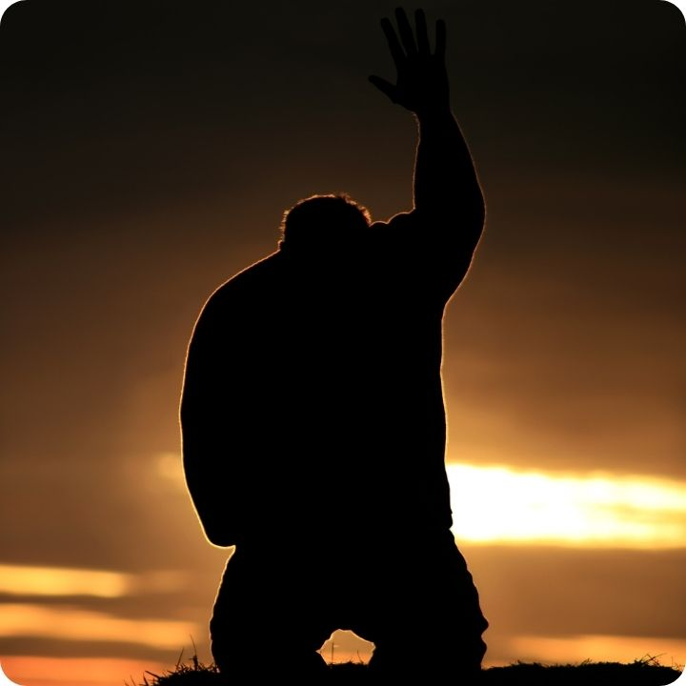
WORSHIP
Let’s prepare our hearts to worship our God of justice, mercy and grace.
O Come To The Altar (Elevation Worship)
I Will Trust My Savior Jesus (CityAlight)
It Is Well (Kristene DiMarco)
Sovereign Over Us (Michael W Smith)
Notes:
Facilitators’ Notes
Time allocated: 15-20min
Tip: as the Spirit leads you, have a short time after worship for people to respond to God in prayer.

Slide 5

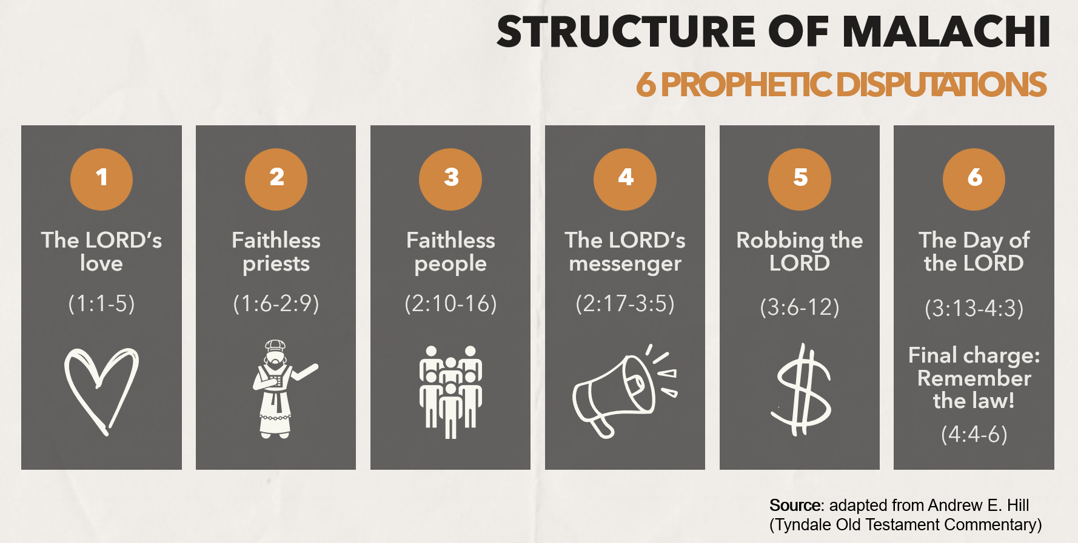
WORD
Notes:
Facilitators’ Notes:
This slide is used by the preachers for related sermons. For reference only.

Slide 6
Activity 1: Watch a Video
Watch this Bible Project video on Justice.
What is one thing that stood out to you from the video about the biblical understanding of justice?
In the rest of this study, we will be looking at a disputation in the book of Malachi that focuses on the topic of justice.
Notes:
Facilitators’ Notes
Time allocated: 10min
Play the video and get different members of the CG to share.
This will introduce the topic of Justice present in the bible study

Slide 7
Activity 2: Read & Discuss
Read Malachi 2:17 and answer Questions 1 and 2:
What was the charge that the people were bringing against God?
Why do you think it was wearying to God?
Notes:
Facilitators’ Notes
Time allocated: 5min
The answer can be inferred from the text
This question mainly focuses on giving people a general overview on the problem being addressed: The complaint that the people were bringing against God, and what was wrong with it.

Slide 8

Question 1 Discussion Notes
The people accused God of considering evildoers good, and even delights in them. In effect, they were calling their faithful covenant-keeping God evil!
The people also asked: “where is the God of justice?” The implication of this is that they believed that either (a) God is unjust or (b) God doesn’t exist.
Why this matters: In our moments of suffering and pain, perhaps we too have had grave doubts about God’s goodness and presence in our lives.
*Petterson. Haggai, Zechariah, and Malachi. p 361
Notes:
Facilitators’ Notes
Do not show this to the CG if there is no need to. This is not the “model” answer.
You can show this slide only when the CG is completely stuck and unable to proceed.
Don’t show it too soon because that will kill all thinking and discussion.

Slide 9
Question 2 Discussion Notes
God was wearied by His people’s faithlessness. They had forgotten His covenantal love and His past deliverance (He brought them back from exile!) – that’s why they could call God evil.
God was also wearied by the fact that His people were far from Him. They lamented to each other about His supposed injustice – but did not bring these laments to Him in prayer!*
Why this matters: One third of the psalms in the Bible are laments – complaint prayers directed to God. Let’s bring our burdens and frustrations to God honestly, in prayer – rather than complaining about God to ourselves and others.
*Petterson. Haggai, Zechariah, and Malachi. p 361
Notes:
Facilitators’ Notes
Do not show this to the CG if there is no need to. This is not the “model” answer.
You can show this slide only when the CG is completely stuck and unable to proceed.
Don’t show it too soon because that will kill all thinking and discussion.

Slide 10


Exegetical Insight: who was the messenger of the covenant (Mal 3:1)?
3:1 mentions the “messenger of the covenant”.
While scholars disagree as to the identity of this messenger (whether Yahweh himself, a messianic or a prophetic figure), more important is his function – to enforce the terms of the Mosaic covenant and refine God’s priesthood and people to follow it.
In the New Testament – John the Baptist is the fulfilment of the messenger who goes before the Lord Jesus to prepare the way.
“The Lord suddenly coming to his temple” is also fulfilled by Jesus in the New Testament.
Notes:
Facilitators’ Notes
Time allocated: 2min
Get different members of the CG to read out. Do not get stuck on this. This is meant to provide a deeper understanding of the text and pique people’s interest to know more.
It’s meant to help push towards the main takeaways of the study.

Slide 11
Activity 3: Read & Discuss
Read Malachi 3:1-4 and answer questions 3 and 4
How does the reply about the sending of the messenger and the arrival of the LORD Himself address the people’s charge of injustice? (Read Mal 3:2)
What will take place when the Lord and His messenger come?
Notes:
Facilitators’ Notes
Time allocated: 10min
This question is open to their interpretation and meant to clarify the logic and force of the prophet’s argument

Slide 12
Question 3 Discussion Notes
The people accused God of being absent, and doing nothing.
So the LORD replies that both He and His messenger are coming (Mal 3:1). God would soon be present with them, and they will know it!
But Mal 3:2 tells us this presence is not going to be pleasant – “who can endure the day of His coming?”
Perhaps from that we can infer that the Lord is employing some sarcasm in verse 1 – the people did not truly seek the Lord or delight in His messenger.
Notes:
Facilitators’ Notes
Do not show this to the CG if there is no need to. This is not the “model” answer.
You can show this slide only when the CG is completely stuck and unable to proceed.
Don’t show it too soon because that will kill all thinking and discussion.

Slide 13
Question 4 Discussion Notes
When the LORD appears He will be like refiner’s fire and a fuller’s soap – a fuller was a person who was responsible for the cleaning and whitening of cloth (Mal 3:2).
He will purify and refine the sons of Levi (the priests and Levites) so that they can once again bring righteous offerings to God (Mal 3:4).
This then reveals the true problem that the people were facing: not that God was absent or unjust, but that His people themselves were corrupt and unfaithful to God!*
Why this matters: we too need the Lord to purify and refine us.
*Petterson. Haggai, Zechariah, and Malachi. p. 364.
Notes:
Facilitators’ Notes
Do not show this to the CG if there is no need to. This is not the “model” answer.
You can show this slide only when the CG is completely stuck and unable to proceed.
Don’t show it too soon because that will kill all thinking and discussion.

Slide 14
Activity 4: Read & Discuss
Read Malachi 3:5 and answer Question 5
How does the reply that God will draw near to His people in judgment address the people’s charge of injustice?
Notes:
Facilitators’ Notes
Time allocated: 10min
This question is open to their interpretation and meant to clarify the logic and force of the prophet’s argument

Slide 15
Question 5 Discussion Notes
The people were judging God for being unjust, but now God turns the tables on them: “I will draw near to you for judgment.” He comes to them as the judge.
The people had accused God of being slow to act, but God says: I will be a “swift witness” against the unjust people of God. God has witnessed their crimes! He is not blind!
Ironically, the people who accused God of injustice were themselves unjust: they were adulterers (maritally unfaithful), swore falsely (lacked integrity), oppressed the marginalized, and did not care about the sojourners (non-Israelites).
Why this matters: we too are often more concerned about what we perceive as God’s unfairness to us than our unfairness to others.
Notes:
Facilitators’ Notes
Do not show this to the CG if there is no need to. This is not the “model” answer.
You can show this slide only when the CG is completely stuck and unable to proceed.
Don’t show it too soon because that will kill all thinking and discussion.

Slide 16

Prayerfully reflect on these questions
Do you struggle with a sense that God is unfair to you (e.g. you may wonder why God has not blessed you in certain ways, other people have it better, etc.)?
Do you struggle with a sense that God is unfair to others in the world (e.g. because of injustices that we see)?
How might our study of Mal 2:17 – 3:5 changed your perspective of God’s fairness and justice and our response to injustice?
Thought to chew on: When we see what’s wrong in our world and cry out to God for justice, let us also consider whether we are pursuing God’s justice through our own actions towards others.
Notes:
Facilitators’ Notes
Time allocated: 10min
CG members can choose which of the 3 questions they would like to share on.
Question 1 is more personal.
Question 2 may appeal to CG members who are concerned about matters of social justice.
Question 3 gets CG members to consider whether their conceptions of fairness/justice align with a biblical perspective on justice (introduced in the Bible Project video).

Slide 17
Share and pray for one another
Share your reflections on any of the three questions with others in your small group. Be as authentic as you can be.
Use these pointers as you pray for one another:
  Commit our feelings of injustice/unfairness to God
  In faith, ask God to intervene in bleak and unjust situations – to bring healing and transformation
  Pray that God would cleanse us of injustice – He is our refining fire.
  Ask that the LORD would empower us to be His representatives in the world that usher in His justice and peace in our areas of influence.
Notes:
Facilitators’ Notes
Time allocated: 20min
Do this in sub-groups / accountability groups to give people more time to share, and to increase the level of psychological safety as people may want to share vulnerably
Encourage CG members to pray for one another, so that there is a habit of having a theo-centric response to life’s challenges.

Slide 18

Additional Resources for Further Study
Hill, Andrew. Haggai, Zechariah and Malachi. Vol 28. Tyndale Old Testament Commentaries. Nottingham: Inter-varsity Press. 2012.
Petterson, Anthony R. Haggai, Zechariah, and Malachi. Apollos Old Testament Commentary. Downers Grove, IL: IVP Academic, 2015.
Baldwin, Joyce G. Haggai, Zechariah and Malachi: An Introduction and Commentary. Vol. 28. Tyndale Old Testament Commentaries. Downers Grove, IL: InterVarsity Press, 1972.
Verhoef, Pieter A. The Books of Haggai and Malachi. The New International Commentary on the Old Testament. Grand Rapids, MI: Wm. B. Eerdmans Publishing Co., 1987.
Taylor, Richard A., and E. Ray Clendenen. Haggai, Malachi. Vol. 21A. The New American Commentary. Nashville: Broadman & Holman Publishers, 2004.
Notes:
Facilitators’ Notes
Share only to those who are keen.

