Slide 1
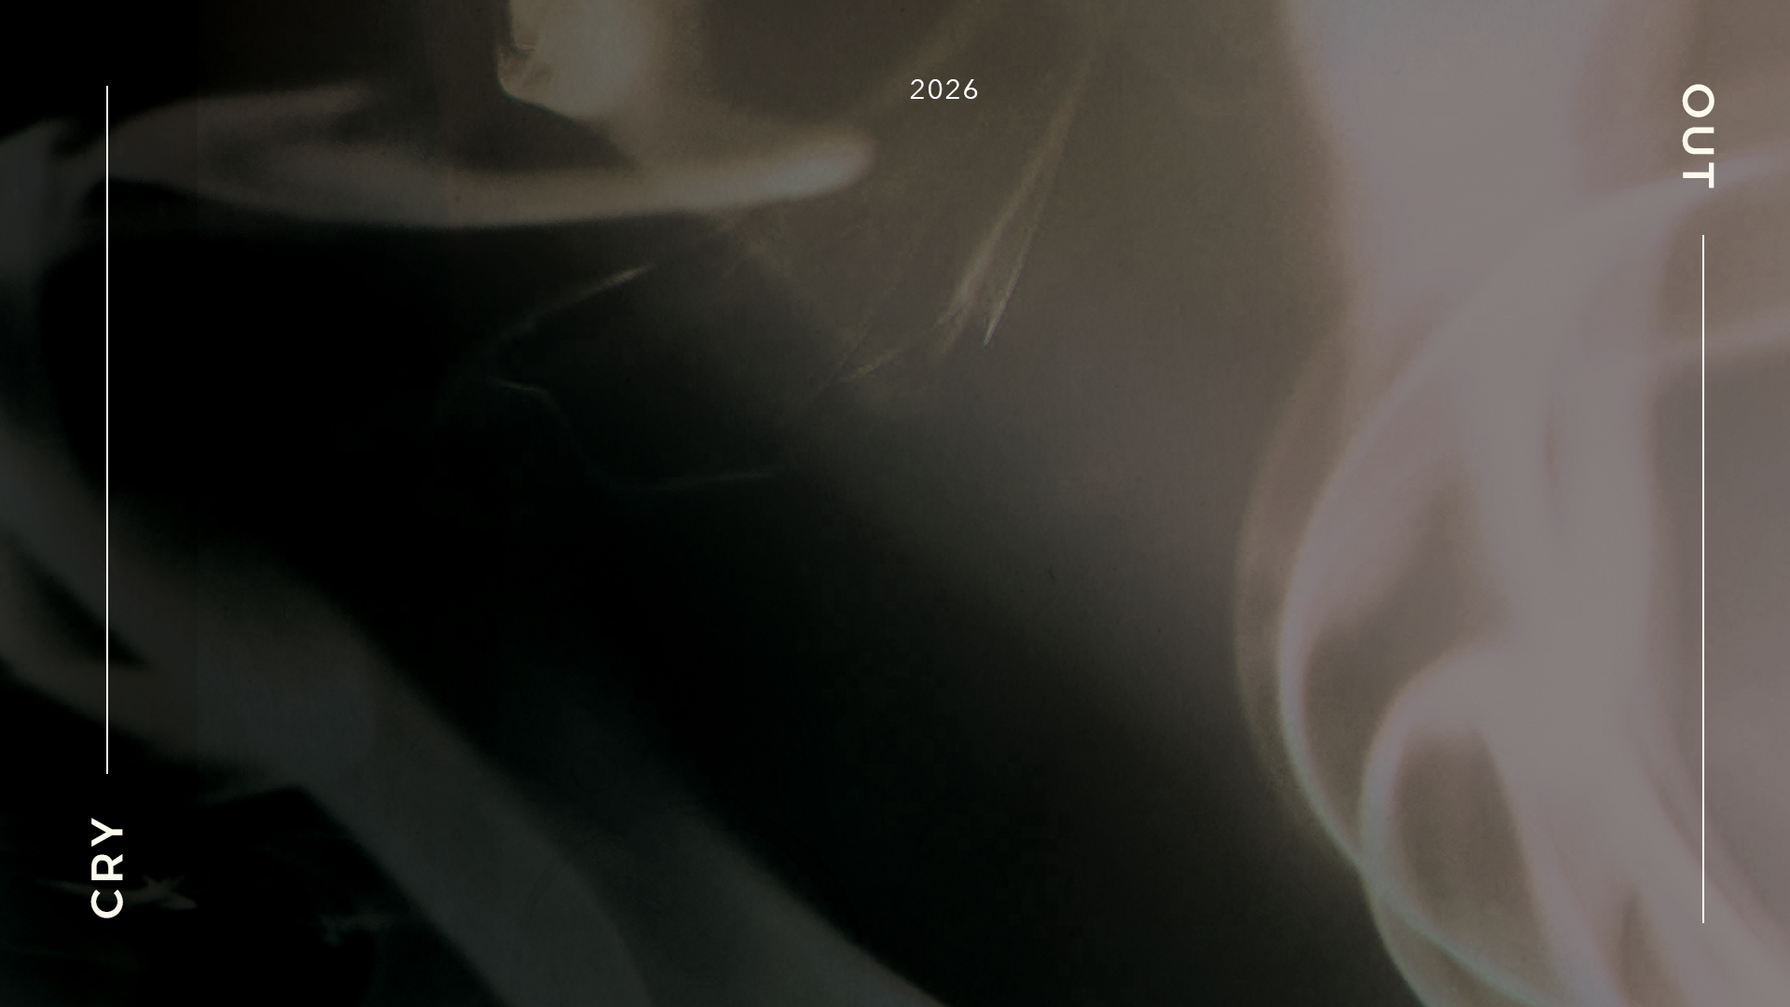

POSTEXILIC
PROPHETS
HAGGAI, ZECHARIAH & MALACHI

Slide 2
STUDY 8
IS OUR WORSHIP DEFILED?
(Malachi 1: 6 – 2:9)

Slide 3



WELCOME
Ice-breaker Activity: A Great Gift?
Each person shares (in one minute) one meaningful gift which they had received from someone and what made it meaningful.
Notes:
Facilitators’ Notes
Time allocated: 15 min
The objective of the activity is to build psychological safety in the group, and get group members to learn to listen to one another and grow in sharing something a bit vulnerable/authentic.
The idea of the “gift” is connected to the blemished gifts that people were bringing before the Lord.

Slide 4
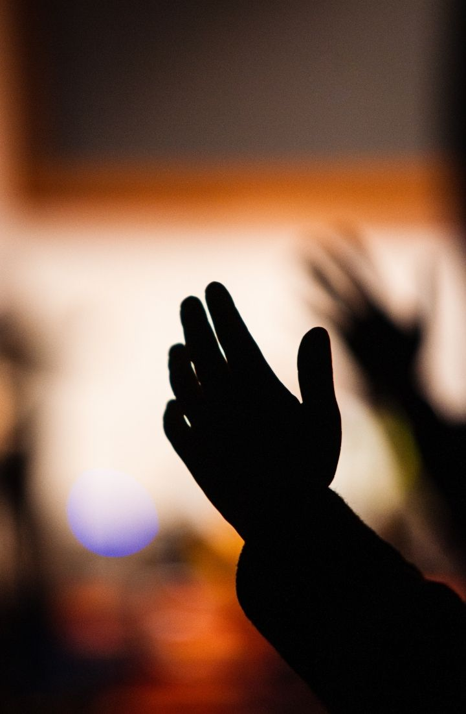

WORSHIP
Let's prepare our hearts to bring an offering of worship to the King.
Offering (Paul Baloche)
Heart of Worship (Matt Redman)
I Offer My Life (Don Moen)
Worth It All (Awaken Generation)
Notes:
Facilitators’ Notes
Time allocated: 15-20min
Tip: as the Spirit leads you, have a short time after worship for people to respond to God in prayer.

Slide 5

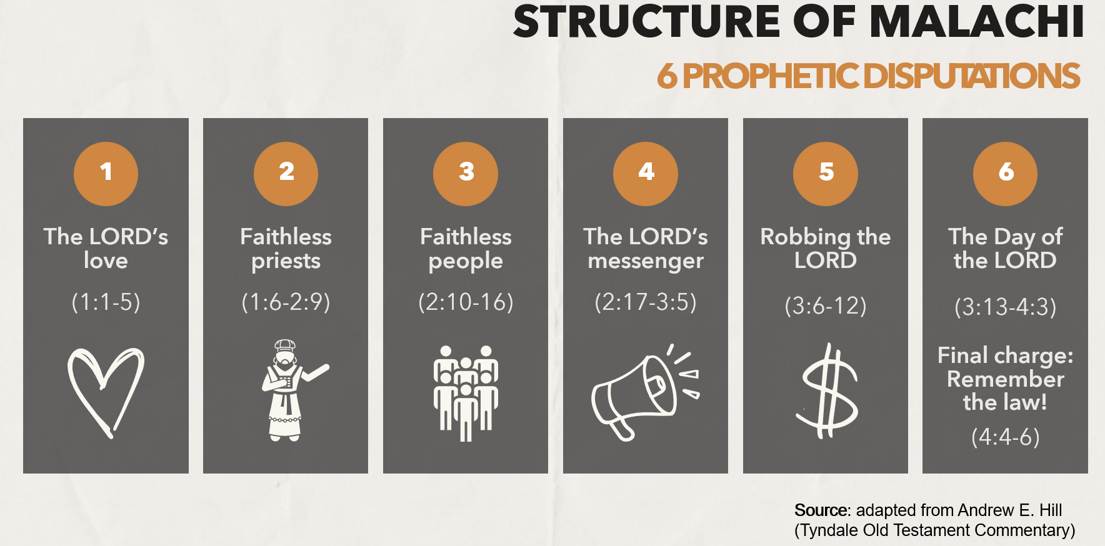
WORD
Notes:
Facilitators’ Notes:
This slide is used by the preachers for related sermons. For reference only.

Slide 6

Setting the Context: Offerings & Sacrifices in the Old Testament
A key element of Israelite worship included offering sacrifices at the altar (Lev 1-6), and the priests were entrusted with offering on the altar the sacrifices brought by the people.
Mosaic law details the requirements of these sacrifices, and clearly prohibited the offering of blemished animals, including those that were lame or blind (Lev 22:18-25; Deu 15:21).
Sinfulness and impurity constantly threatened the unique covenantal relationship that the Israelites had with a holy God. Thus, sacrifices were a God-given means by which the people could be cleansed, and this relationship with God maintained, despite their shortcomings.
Notes:
Facilitators’ Notes
Time allocated: 2min
Get different members of the CG to read out. This is a review of what we had covered in Leviticus.
Explain that this context is necessary to help them understand today’s passage.

Slide 7
Setting the Context: What Offerings & Sacrifices mean for us today
In the NT, Jesus is depicted as the one perfect sacrifice (Heb 10:12,14) which reconciled to God a sinful people who have received his atoning work by grace (Rom 3:21-26).
Petterson says: “The language of sacrifice or worship [is used] … to speak of the actions Christians should do in response to all that God has done in Christ.”
Christians are called to “offer [their] bodies as a living sacrifice” to God as worship (Rom 12:1-2; 6:13, 16).*
*Petterson, Anthony R. Haggai, Zechariah, and Malachi. Apollos Old Testament Commentary. Downers Grove, IL: IVP Academic, 2015, p. 343.
Notes:
Facilitators’ Notes
Time allocated: 2min
Get different members of the CG to read out.
This is meant to bridge for the CG how the offerings and sacrifices in the OT relates to worship in our modern-day Christian context.

Slide 8
Activity 1: Read & Discuss
Read Malachi 1:6-14 and answer Questions 1 & 2.
What is the problematic situation that the prophet is addressing among God’s people?
How does Malachi use the analogy of giving gifts to one’s governor (Mal 1:8) to point out the people’s wrongdoing?
Notes:
Facilitators’ Notes
Time allocated: 5min
The answer can be inferred from the text
This question mainly focuses on giving people a general overview on the problem being addressed: the actions of the people who were bringing the offerings and the quality of these offerings.
Note: we will discuss the actions and attitudes of the priests later on in the study.

Slide 9

Question 1 Discussion Notes
The situation was this: people were bringing blemished and impure animals as offerings to the temple as offerings (1:8, 13), and the priests were allowing this to happen!
Feeling obliged to participate in the sacrificial rituals, the people were giving up the animals from their flock which were worth the least while keeping the best for themselves.
Mal 1:14 shows that some people were voluntarily making vows to God in exchange for His deliverance in their situations (see Lev 22:18-19) but then breaking their part of the vow afterward.
Notes:
Facilitators’ Notes
Do not show this to the CG if there is no need to. This is not the “model” answer.
You can show this slide only when the CG is completely stuck and unable to proceed.
Don’t show it too soon because that will kill all thinking and discussion.

Slide 10
Question 2 Discussion Notes
Malachi depicts God using irony to reveal the absurdity of what His people were doing.
It would be hard to imagine giving a blemished animal as a gift to one’s governor, yet they didn’t think twice about offering the same to the Lord of the universe!
Notes:
Facilitators’ Notes
Do not show this to the CG if there is no need to. This is not the “model” answer.
You can show this slide only when the CG is completely stuck and unable to proceed.
Don’t show it too soon because that will kill all thinking and discussion.

Slide 11
Crucial context: Who were the priests in Old Testament times?
In the context of Malachi, there is no distinction made between the priests and the Levites whether in rank or function. They played the “dual roles of worship leader and teacher”, and were “the ‘national leaders’” of Judah over “the citizens of the province”.*
The Israelite priests were appointed by God as mediators between the divine and human realms, in charge of the temple duties (which included the sacrificial offerings) and of teaching and instructing the people (Mal 2:5-9).
*Hill, Andrew. Haggai, Zechariah and Malachi.
Notes:
Facilitators’ Notes
Time allocated: 2min
Get different members of the CG to read out. Do not get stuck on this. This is meant to be basic background context to get everyone up to quickly.
Can skip if members already know this.

Slide 12
Crucial context: Who are God’s priests today?
It may be easy to assume that learning from the priests’ actions and attitudes in Malachi only applies to religious leaders and teachers of our day.
Yet, the NT, through passages like 1 Pet 2:9, teaches us that all believers in Christ are priests!
As we are called not only to be disciples but disciple-makers, we are called similarly to walk with God in peace and uprightness, guarding knowledge and instruction as part of our gospel witness to those around us.
Why this matters: What God says to the priests is applicable to all of us as well (not just pastors), because we are His priests that bridge others to Him.
Notes:
Facilitators’ Notes
Time allocated: 2min
Get different members of the CG to read out.
This is meant to bridge for the CG how the priesthood in the OT relates to our modern-day Christian context.

Slide 13
Activity 2: Read & Discuss
Read Malachi 1:12 to 2:9 and answer Questions 3 to 5
Looking at 1:12-13, what seem to be some of the attitudes behind the priests’ actions in allowing this problematic situation to occur?
In 2:1-3, what shocks you the most out of all the things that God says here to the priests? Why?
What was God expecting from the priests, as reflected in his covenant with Levi (2:4-9)?
Notes:
Facilitators’ Notes
Time allocated: 10min
Qn 3 focuses now on the priests’ attitudes towards sacrificial worship at the temple, and answers can be inferred from the text.
Qn 4 is an open question to see what members find harsh or surprising about all that is attributed to God’s speech in these verses. There is no right or wrong answer.
Qn 5 requires members to observe and draw out inferences based on how the ideal state of God’s relationship with Levi is described.
Questions should allow for different views to be aired, and where necessary, the facilitator could prompt answerers to share where they see their points evidenced in the text.

Slide 14
Question 3 Discussion Notes
The priests had a low view of the Lord’s altar and sacrifices offered. They could have been influencing the people with their view – “you say that the Lord’s table is polluted … the food may be despised” (v7, 12).
The priests considered the rituals of offering and sacrifice a chore and treated it with contempt - “you say, ‘what a weariness this is’, and you snort at it” (v13)
The priests’ repeated questioning “how have we polluted you?” sounds like feigned innocence – a refusal to admit wrong, despite knowing they had displeased God.
Why this matters: do we find worshipping and serving God a chore or a privilege?
Notes:
Facilitators’ Notes
Do not show this to the CG if there is no need to. This is not the “model” answer.
You can show this slide only when the CG is completely stuck and unable to proceed.
Don’t show it too soon because that will kill all thinking and discussion.

Slide 15
Question 4 Discussion Notes
The prophet uses several shocking statements in God’s rebuke of the priests to convey the severity of their actions and jolt them awake.
“The curse” in Malachi 2:2 likely refers to the curses in the Mosaic covenant - consequences of disobedience (Deu 28:20). God was sending curses upon them!
“Curse your blessings” (2:2) imply that the priest’s role of blessing the people had been “inverted” and that the priest had become a curse to God’s people instead. Ouch!*
*Petterson. Haggai, Zechariah, and Malachi. p 338.
Notes:
Facilitators’ Notes
Do not show this to the CG if there is no need to. This is not the “model” answer.
You can show this slide only when the CG is completely stuck and unable to proceed.
Don’t show it too soon because that will kill all thinking and discussion.

Slide 16
Question 4 Discussion Notes (cont’d)
Malachi 2:3 is very graphic. God is effectively saying “I will splatter crap on your faces – the crap of your festivals”! That’s how pointless the festivals had become. (Note: “Crap” is “dung” or “refuse” in other translations)
If the priests really had dung on them, they would be defiled, unable to carry out their role, fit only to be dumped on the dung heap outside the camp.* That’s why the last phrase in Malachi 2:3 is: “and you shall be taken away with it”. God would remove the priests for they had become worthless.
Why this matters: how do we respond to hard scoldings from God?
*Petterson. Haggai, Zechariah, and Malachi. p 339.
Notes:
Facilitators’ Notes
Do not show this to the CG if there is no need to. This is not the “model” answer.
You can show this slide only when the CG is completely stuck and unable to proceed.
Don’t show it too soon because that will kill all thinking and discussion.

Slide 17
Question 5 Discussion Notes
The priests, descended from the line of Levi, had a special relationship of responsibility and privilege – akin to a covenant. The OT tells of how God made a covenant with Phinehas, a Levite, in Numbers 25.*
This relationship between God and his priests was meant to be marked by life and peace, reverent fear and awe (2:5).
The Levites were meant to instruct God’s people in the law, guarding knowledge and instruction (2:6-7). In doing so, they would preserve uprightness, and turn many from iniquity (2:6).**
Why this matters: do we grasp what a privilege it is to be God’s priests?
*Petterson. Haggai, Zechariah, and Malachi. p. 339.
**Ibid. p. 340.
Notes:
Facilitators’ Notes
Do not show this to the CG if there is no need to. This is not the “model” answer.
You can show this slide only when the CG is completely stuck and unable to proceed.
Don’t show it too soon because that will kill all thinking and discussion.

Slide 18

Exegetical Insight: Is God being sarcastic?
Yes, the prophet seems to depict God using sarcasm to intensify his rebuke of the priests and people in Malachi.
The repeated statement in 1:8 can actually be read as a sarcastic declaration by the prophet “When you offer blind animals in sacrifice, there is no evil! And when you offer those that are lame or sick, there is no evil!” (cf. NJPS, ‘it doesn’t matter!’; NEB, ‘there is nothing wrong’).*
“And now, entreat the favor of God, that he may be gracious to us.” (1:9) is a sarcastic reference to the Aaronic benediction (Num 6:24-26), which was a prayer the priests were supposed to pray to garner God’s favour on behalf of the people.
*Hill, Andrew. Haggai, Zechariah and Malachi. Vol 28. Tyndale Old Testament Commentaries. Nottingham: Inter-varsity Press. 2012.
Notes:
Facilitators’ Notes
Time allocated: 3min
You can decide whether or not to read this out, depending on whether it is a question people want answered.
This is meant to provide a deeper understanding of the text and pique people’s interest to know more
Can skip if short on time

Slide 19
Exegetical Insight: Is God being sarcastic?
“My name will be great among the nations” (1:11) – sarcastically turns the comfort in Malachi 1:5 into a harsh jab – while Israel fails to worship their God, every other nation and place will offer up pure offerings to YHWH.
Why this matters: We cannot conclude from the speech of God that it is perfectly okay to be sarcastic to one another (it can be hurtful). Rather, all this shows that God is not afraid of using cutting words to pierce his people’s hardened hearts – words that come from a heart of love. When God has a tough message for us, do we listen? Or do we take offence?
Notes:
Facilitators’ Notes
Time allocated: 3min
You can decide whether or not to read this out, depending on whether it is a question people want answered.
This is meant to provide a deeper understanding of the text and pique people’s interest to know more
Can skip if short on time

Slide 20

Prayerfully reflect on your own
What do you identify with in Malachi’s depiction of God’s people and priests?
What is something that God might be revealing to you about your attitude or behaviour in your worship or witness?
Is there anything that surprised you today about the way God communicates with his people?
Notes:
Facilitators’ Notes
Time allocated: 15min
For question 1, the focus is on how they see themselves as relating with either the roles, situations, or attitudes of the people and priests of the time.
Question 2 requires CG members to first reflect and be convicted about particular aspects of their own attitudes and behaviours. Members could choose to answer either about worship or witness – or both together, since these are integrated concepts.
Question 3 is an optional alternative question which allows CG members to reflect on the prophet’s depiction of God’s speech. It is an open question, though possible takeaways could be the use of irony or harsh rebuke in order to get through to his people, and what that reveals about God.

Slide 21
Share and pray for one another
Share your reflections on the three questions with others in your small group. Be as authentic as you can be.
Remember to keep confidence and maintain a safe space for one another.
Pray for one another, committing what is shared to the LORD in prayer.
Notes:
Facilitators’ Notes
Time allocated: 20min
Do this in sub-groups / accountability groups to give people more time to share, and to increase the level of psychological safety as people may want to share vulnerably
Encourage CG members to pray for one another, so that there is a habit of having a theo-centric response to life’s challenges.

Slide 22

Additional Resources for Further Study
Hill, Andrew. Haggai, Zechariah and Malachi. Vol 28. Tyndale Old Testament Commentaries. Nottingham: Inter-varsity Press. 2012.
Petterson, Anthony R. Haggai, Zechariah, and Malachi. Apollos Old Testament Commentary. Downers Grove, IL: IVP Academic, 2015.
Baldwin, Joyce G. Haggai, Zechariah and Malachi: An Introduction and Commentary. Vol. 28. Tyndale Old Testament Commentaries. Downers Grove, IL: InterVarsity Press, 1972.
Verhoef, Pieter A. The Books of Haggai and Malachi. The New International Commentary on the Old Testament. Grand Rapids, MI: Wm. B. Eerdmans Publishing Co., 1987.
Taylor, Richard A., and E. Ray Clendenen. Haggai, Malachi. Vol. 21A. The New American Commentary. Nashville: Broadman & Holman Publishers, 2004.
Notes:
Facilitators’ Notes
Share only to those who are keen.

