Slide 1

POSTEXILIC
PROPHETS
HAGGAI, ZECHARIAH & MALACHI

Slide 2
STUDY 7
DO WE DOUBT GOD’S LOVE?
(Malachi 1:1-5 with Introduction to book of Malachi)

Slide 3


WELCOME
Ice-breaker Activity: "I love you..."
Each person shares (in 1 minute) the last time they expressed or showed love to someone, and how the hearer responded to it.
Notes:
Facilitators’ Notes
Time allocated: 15 min
The objective of the activity is to build psychological safety in the group, and get group members to learn to listen to one another and grow in sharing something a bit vulnerable/authentic.

Slide 4

WORSHIP
Worship our God who is love. May He help us rest in the goodness of Jesus.
The Love of God (Reawaken Hymn)
Love of God (Phil Wickham & Brandon Lake)
How Deep the Father’s Love for Us (LOVKN, Isaiah Pekary)
The Goodness of Jesus (CityAlight)
Notes:
Facilitators’ Notes
Time allocated: 15-20min
Tip: as the Spirit leads you, have a short time after worship for people to respond to God in prayer.

Slide 5
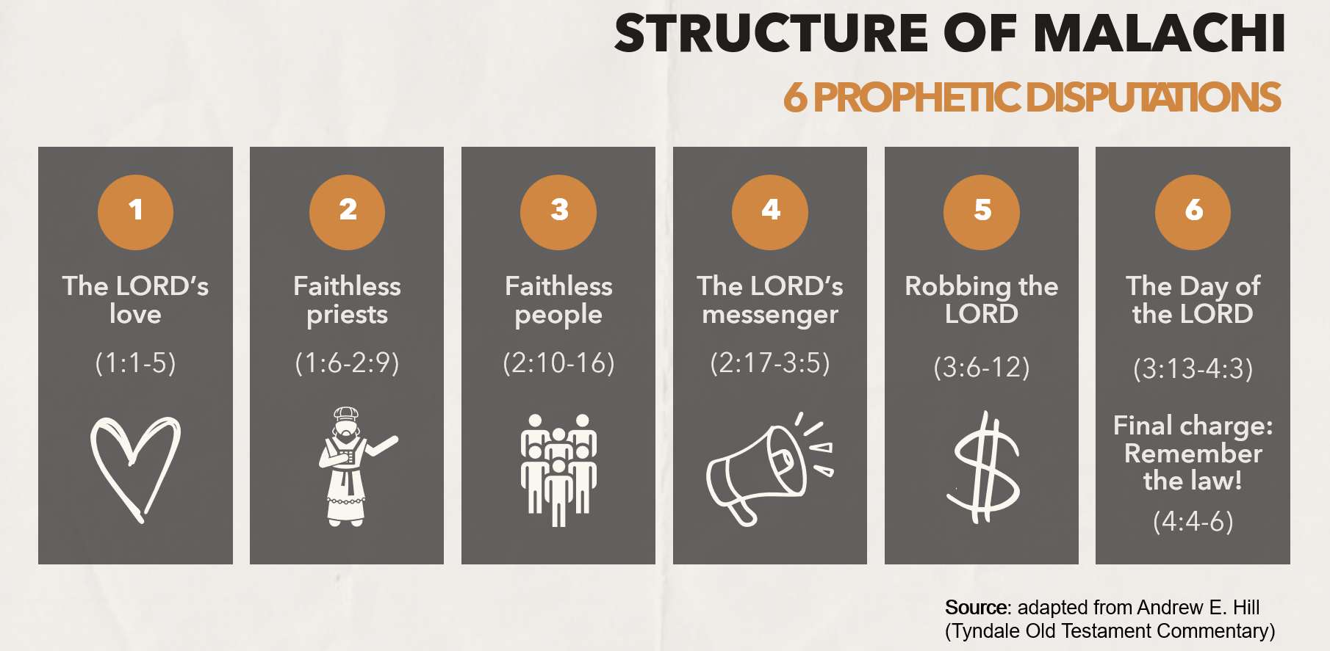
WORD
Notes:
Facilitators’ Notes:
This slide is used by the preachers for related sermons. For reference only.

Slide 6
Activity 1: Watch a Video
This short Bible Project video summarises the context, structure and message of the book of Malachi. After you view it, discuss the following question:
  Based on what is depicted in the book, do you think that God’s people deserved his love? Why or why not?
Notes:
Facilitators’ Notes
Time allocated: 15min
This is meant to be a question to draw attention to how the people of Judah are portrayed in the book of Malachi, and to potentially hint at the surprising nature of God’s declaration of love for them.

Slide 7
Q1 Discussion Notes
Malachi is full of examples of how God’s people were failing to live up to the standards expected of them. They were offering polluted sacrifices to God, finding service to God tiresome, being unfaithful to their wives, failing to bring their tithes into the Temple, and committing injustice in the city.
By any normal standards, the people’s failures would have rendered them undeserving of God’s love.
Even if we were to say that God’s love doesn’t depend on one’s actions, the fact remains that any love God shows to his people is an undeserved extension of grace!
Notes:
Facilitators’ Notes
Do not show this to the CG if there is no need to. This is not the “model” answer.
You can show this slide only when the CG is completely stuck and unable to proceed.
Don’t show it too soon because that will kill all thinking and discussion.

Slide 8

The Context of Malachi
Malachi is situated some time after the rebuilding of the temple (Haggai and Zechariah), close to when Ezra and Nehemiah carried out their ministries.
Since the completion of the temple around 515 BC, God’s people living in Judah had been in a long period of waiting (around 70-80 years) with what seemed like little sign of God’s active presence:
  God’s Messiah had not yet come to deliver Israel and establish the glorious kingdom.
  God’s people were still experiencing poverty and foreign domination under Persian rule.
  The poor and oppressed of the city were being taken advantage of, and evildoers seemed to be getting off scot-free.*
* Adapted from Baldwin, Joyce G. Haggai, Zechariah and Malachi: An Introduction and Commentary. Vol. 28. Tyndale Old Testament Commentaries. Downers Grove, IL: InterVarsity Press, 1972.
Notes:
Facilitators’ Notes
Time allocated: 2min
Get different members of the CG to read out. Do not get stuck on this. This is meant to be basic background context to get everyone up to quickly.
Can skip if members already know this.

Slide 9
Activity 2: Read and Discuss
Read Malachi 1:1-5 and answer Question 2
2. Given the context of God’s people in the time of Malachi, why do you think that they asked God, “How have you loved us” (v.2)?
Note: Consider how “I love you, and I have always loved you” is one way to render the sense of God’s statement in verse 2, where Hebrew perfect verb (“have loved”) implies a continuous action (of loving) that began in the past and continues into the present.
Notes:
Facilitators’ Notes
Time allocated: 5min
If it helps, reference could be made back to what was shared by CG members during the welcome question.
Younger/newer Christians may be at a loss of how to answer. That’s ok. Let the more mature Christians provide the responses.

Slide 10
Question 2 Discussion Notes
Peter Verhoef rightly points out that we cannot condone the people’s questioning of God’s love, but we can appreciate why they doubted.
He writes: “their expectations of a glorious renewal of their national life after the return from exile had been disappointed. The promised kingdom of the Messiah had still not dawned... They still remained under Persian rule (1:8) and were suffering from pests and plagues (2:17; 3:11, 12).”*
In other words, their suffering made it hard for them to feel God’s love.
Why this matters: do hard circumstances in our lives make it difficult for us to “feel” God's love for us? Do we remind ourselves how He has loved us, from the past till now?
*Verhoef, Pieter A. The Books of Haggai and Malachi. The New International Commentary on the Old Testament. Grand Rapids, MI: Wm. B. Eerdmans Publishing Co., 1987, 198.
Notes:
Facilitators’ Notes
Do not show this to the CG if there is no need to. This is not the “model” answer.
You can show this slide only when the CG is completely stuck and unable to proceed.
Don’t show it too soon because that will kill all thinking and discussion.

Slide 11
Activity 3: Read & Discuss
Based on Malachi 1:2-3, answer Question 3:
What do you think the mention of the brotherhood between Jacob and Esau (read the context below) was meant to communicate to God’s people?
Background context: Genesis tells us how God entered into a covenant with Abraham. God's covenant promises continued with Isaac. Of Isaac’s two sons, he chooses Jacob (whom he later renames “Israel”) and his descendants to be his people. Esau, Jacob’s older twin brother, was excluded from this promise, and his descendants became the people of Edom.
Notes:
Facilitators’ Notes
Time allocated: 5min
Younger/newer Christians may be at a loss of how to answer. That’s ok. Let the more mature Christians provide the responses.

Slide 12
Question 3 Discussion Notes
Malachi is reminding God’s people that even though the two were brothers (even twins!), God had chosen Israel to be his privileged covenant people, while Esau was not chosen despite being older. In Biblical times, being older/more senior usually meant that one had more “merit”.
In response to their question (“how have you loved us?”), this statement asserts that God’s choice of Jacob (and thus Israel) was based on His grace, rather than any human merit!
Read Deuteronomy 7:7-8 for an explanation of why God chose Israel! Do we recognize that God has also chosen us purely out of grace?
Notes:
Facilitators’ Notes
Do not show this to the CG if there is no need to. This is not the “model” answer.
You can show this slide only when the CG is completely stuck and unable to proceed.
Don’t show it too soon because that will kill all thinking and discussion.

Slide 13

Exegetical Insight 1: Does God really “hate” Esau?
We may have problems with the word “hate”. We wonder, how is it fair for God to decide He hates Esau? And isn’t He a God of love?
Joyce Baldwin explains: “The verb ‘hate’ is to be understood in the light of God’s electing love. The very fact that Jacob was chosen, ‘loved’, meant that Esau was rejected, ‘hated’, rejection being implicit in the exercise of choice.”*
In other words, hated just means that God did not choose Esau. There was no personal animosity to Esau.
*Baldwin, Haggai, Zechariah and Malachi, 240.
Notes:
Facilitators’ Notes
Time allocated: 3min
You can decide whether or not to read this out, depending on whether it is a question people want answered.
This is meant to provide a deeper understanding of the text and pique people’s interest to know more
Can skip if short on time

Slide 14
Exegetical Insight 2: Who were the Edomites and what became of them?
Scripture depicts a bitter history between Judah and Edom (cf. Num 20:14–21; 1 Kgs 11:14–16).
During the Babylonian invasion of Judah in 587 BC, Edom participated in the destruction and looting of the city (e.g. Ezek. 25:12; Obad. 10–16), cutting off the escape of its inhabitants, and delivering Judean captives to Babylon (Obad. 14).*
The entire book of Obadiah is about how Edom was judged for sinning against God and God’s people
*Verhoef, The Books of Haggai and Malachi, 203; Taylor, Richard A., and E. Ray Clendenen. Haggai, Malachi. Vol. 21A. The New American Commentary. Nashville: Broadman & Holman Publishers, 2004, 209.
Notes:
Facilitators’ Notes
Time allocated: 2min
Get different members of the CG to read out (there’s no need to read the scriptural references).
This historical background is needed to answer question 4, so read through it.

Slide 15
Exegetical Insight 2: Who were the Edomites and what became of them?
But later in the 5th century, the city of Edom was overrun and its inhabitants gradually pushed out from their country by the Nabatean Arabs. This likely happened before the time of Malachi.*
Even after the time of Malachi, the Edomites were also defeated by the Maccabees and their cities destroyed.**
Why this matters: We must remember that God was fair in His judgment against Edom – it wasn’t arbitrary. God is a just judge! He cannot be mocked. We sow what we reap.
*Baldwin, Haggai, Zechariah and Malachi, 240.
**Verhoef, The Books of Haggai and Malachi, 203.
Notes:
Facilitators’ Notes
Time allocated: 2min
Get different members of the CG to read out. Do not get stuck on this. This is meant to be basic background context to get everyone up to speed quickly.

Slide 16
Activity 4: Read & Discuss
Read Malachi 1:2-5 and answer Questions 4 and 5
How do God’s declarations against Edom in Mal 1:2-4 relate to what had happened to them in historical reality? How do they compare with what had happened with Israel’s own situation during and after exile?
How does God’s final declaration in Mal 1:5 address the reservations that Israel might have had at first?
Notes:
Facilitators’ Notes
Time allocated: 10min
Qn 3 requires members to compare between what is described in the passage about what has already happened to Edom (Nabatean invasion) and what God promises will happen (not allowed to rebuild) from the viewpoint of Malachi’s original audience – Israel.
Qn 4 should look at both aspects of v5: “your own eyes shall see this”, and “Great is the Lord beyond the borders of Israel”
If helpful, reference can be made back to Qn 1 about the reasons behind why Israel was questioning God’s love
Younger/newer Christians may be at a loss of how to answer. That’s ok. Let the more mature Christians provide the responses.

Slide 17
Question 4 Discussion Notes
The Nabatean attack on Edom corresponds to God’s declaration of having “laid waste his hill country” (Mal 1:3), and their being forced out left their cities empty and deserted.
Edom proudly said that they would rebuild despite God’s judgment upon them, but God declared that He would not allow this to happen. (Mal 1:4) This was fulfilled during the Maccabean period, when Edom was destroyed.
Israel also experienced their city being laid waste, but they experienced the redeeming mercy of God and were allowed to rebuild.
Notes:
Facilitators’ Notes
Do not show this to the CG if there is no need to. This is not the “model” answer.
You can show this slide only when the CG is completely stuck and unable to proceed.
Don’t show it too soon because that will kill all thinking and discussion.

Slide 18
Question 5 Discussion Notes
Firstly, God’s assertion of covenant love is backed up by evidence which their “own eyes” can see for themselves. If they had accused God of being passive and turning a blind eye to injustice against them, then they can see for themselves that this wasn’t true – God judged Edom!
Secondly, it shows that God is sovereign even over other nations “beyond the border of Israel”. They were suffering under foreign rule – but God was reminding them that He ultimately sovereign and exalted over the nations! (Mal 1:5b)
Why this matters: In times of our pain, do we forget that God is sovereign over all things – all our history and all of human history?
Notes:
Facilitators’ Notes
Do not show this to the CG if there is no need to. This is not the “model” answer.
You can show this slide only when the CG is completely stuck and unable to proceed.
Don’t show it too soon because that will kill all thinking and discussion.

Slide 19
Prayerfully reflect on your own
Is there pain or suffering or some other obstacles in your life that makes you doubt God’s love for you?
What is one thing you have experienced in your life which you see as concrete evidence that God loves you?
What is one way you could show others the greatness of God’s love to those “beyond the border” of the church today?
Notes:
Facilitators’ Notes
Time allocated: 15min
For question 1, the focus is on getting CG members to think about questions or experiences which may be contributing to doubts about God’s love and presence.
For question 2, the focus is about being aware of ways in which God has been present and active in our lives.
Question 3 is about encouraging CG members to think about how they could be vessels of God’s love to others today, through practising BLESS or otherwise.

Slide 20
Share and pray for one another
Share your reflections on the three questions with others in your small group. Be as authentic as you can be.
Remember to keep confidence and maintain a safe space for one another.
Pray for one another, committing what is shared to the LORD in prayer.
Notes:
Facilitators’ Notes
Time allocated: 20min
Do this in sub-groups / accountability groups to give people more time to share, and to increase the level of psychological safety as people may want to share vulnerably
Encourage CG members to pray for one another, so that there is a habit of having a theo-centric response to life’s challenges.

Slide 21
Additional Resources for Further Study
Baldwin, Joyce G. Haggai, Zechariah and Malachi: An Introduction and Commentary. Vol. 28. Tyndale Old Testament Commentaries. Downers Grove, IL: InterVarsity Press, 1972.
Verhoef, Pieter A. The Books of Haggai and Malachi. The New International Commentary on the Old Testament. Grand Rapids, MI: Wm. B. Eerdmans Publishing Co., 1987.
Taylor, Richard A., and E. Ray Clendenen. Haggai, Malachi. Vol. 21A. The New American Commentary. Nashville: Broadman & Holman Publishers, 2004.
Notes:
Facilitators’ Notes
Share only to those who are keen.

