Slide 1


POSTEXILIC
PROPHETS
HAGGAI, ZECHARIAH & MALACHI

Slide 2
STUDY 6
"HIM WHOM WE HAVE PIERCED":
A JOURNEY OF REFLECTION, PRAYER AND WORSHIP
(Zechariah 12:1 – 13:9)

Slide 3



WELCOME
For this session…
We will take a break from the usual style of doing Bible study.
Instead, we will be immersing ourselves in the Scriptures in a more reflective and prayerful manner
It would help to have on hand a physical Bible, hard-copy journal and a pen.
You can use your mobile phone to jot down your prayers and reflections but switch it to airplane mode
Get comfortable. Make sure you have a tumbler of water ready, to minimize distractions and movement during the session
Notes:
Facilitator Notes
You may wish to play quiet instrumental worship music in the background, if possible
As best as you can, try to ensure everyone is settled comfortably before the start of the exercise
You could send the slides for this session (in pdf) to your members before the session as this is more of an individual prayer exercise

Slide 4
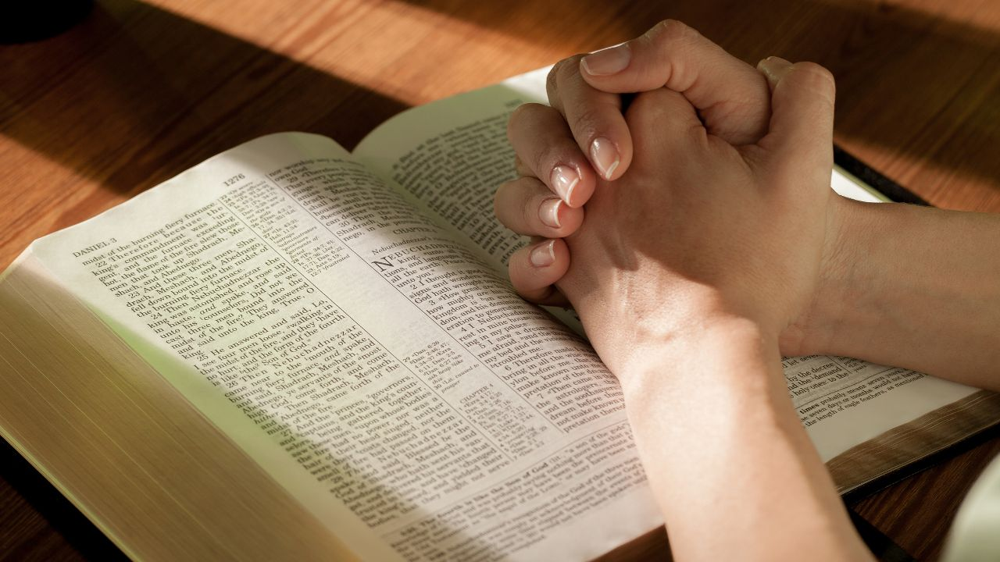
Centering down: A mini-Examen
Give Thanks
Remember the blessings that the Lord has given to you today.
Be specific about so that you can become more grateful for His grace in your life.
Recall God’s Presence
Consider how God was present with you today: through places, events, persons. You may have experienced God being with you even in unpleasant experiences e.g. stressful situations.
If you feel that God was absent in your day, or you were not conscious of Him, reflect on why that may be the case.
Notes:
Facilitator Notes
Time allocated: 10min
This activity is meant to help CG members centre down in God’s presence and still their hearts from the noise and busyness of the week.
An “examen” (especially among Jesuits) a devotional exercise involving reflection on and moral evaluation of one's thoughts and conduct, typically performed on a daily basis. The Examen | Jesuits in Britain

Slide 5


WORSHIP (Segment 1)
Through It All (Hillsong)
Your Presence is Heaven (Israel Hougton & Darlene Zschech)
Notes:
Facilitator Notes
Time allocated: 10min
Worship segment is shorter because we will be integrating worship and prayer throughout the session

Slide 6

WORD
Read: Overview of Zechariah 12:1-13:9
Zechariah 12:1–13:6 represents an oracle from God concerning His salvation plan: God is going to renew His people!
  He will make Jerusalem a fortress impenetrable by the nations, transforming Jerusalem and his Davidic king into a mighty army
  He will provide cleansing, and remove idolatry and false prophecy from the land
The passage contains a number of verses that are quoted in the Gospels and fulfilled in the life of Jesus. We will be praying and reflecting over these together.
Notes:
Facilitator Notes
Time allocated: 1min
Read this out – this provides very brief context to the Scripture passage before we dive into the exercise – to lower the risk of mis-understanding the passage.

Slide 7

Reflect & Pray
Prayerfully reflect on Zechariah 12:10 and John 19:31-37
In Zechariah 12:10 God talks about how His people have pierced Him – what a staggering thought! The Almighty God … pierced?
It is easy to grow apathetic about the fact that we have pierced our LORD Jesus with our sins! Pray for God to pour out His grace upon you that we might mourn for our sin again (Zech 12:10).
Notes:
Facilitator Notes
Time allocated: 20min
Leave this slide projected during the 20min
Play quiet instrumental worship music in the background

Slide 8
Reflect & Pray
Prayerfully reflect on Zechariah 12:10 and John 19:31-37
Prayerfully enter the scene in John 19:31-37. Imagine yourself looking at the lifeless body of Jesus on the cross.
What emotions do you experience as you see the soldier pierce Jesus’s side, causing blood and water to gush out (John 19:34)?
Sit at the foot of the cross, rest in the love that Christ has poured out on you, and believe in Him all over again (John 19:36)
Jot down your thoughts and prayers in your journal.
Notes:
Facilitator Notes
Time allocated: 20min
Leave this slide projected during the 20min
Play quiet instrumental worship music in the background

Slide 9
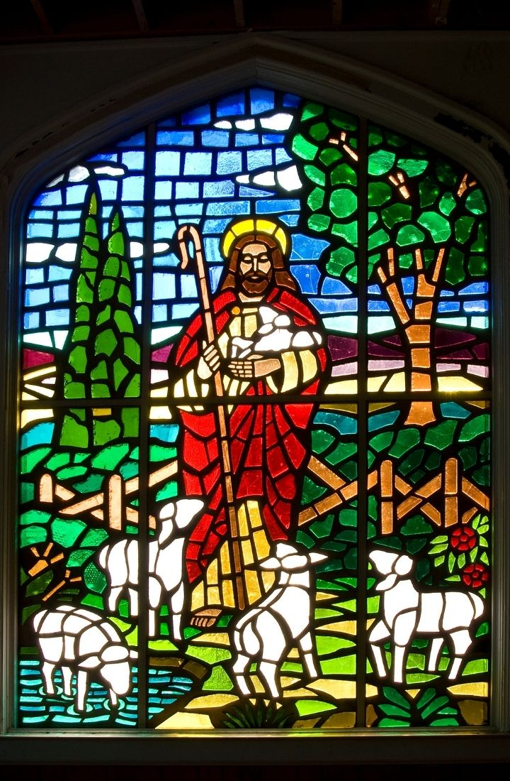
WORSHIP (Segment 2)
Come Behold the Wondrous Mystery (Getty, Matt Boswell & Matt Papa)
Love Ran Red (Chris Tomlin)
Notes:
Facilitator Notes
Time allocated: 10min
Worship segment is shorter because we will be integrating worship and prayer throughout the session

Slide 10
Reflect & Pray
Prayerfully reflect on Zechariah 13:7-9 and Matthew 26:26-35
Don’t miss the irony: right after Jesus institutes the LORD’s supper, which is about His covenantal loyalty to His people, He predicts that His disciples will be disloyal to Him and abandon Him (Matt 26:31)
We too are like Peter – we don’t know how weak and fallible we truly are (Matt 26:32)
Notes:
Facilitator Notes
Time allocated: 20min
Leave this slide projected during the 20min
Play quiet instrumental worship music in the background

Slide 11
Reflect & Pray
Prayerfully reflect on Zechariah 13:7-9 and Matthew 26:26-35
Write a prayer of confession to the Lord about the times you walked away from Him and were disloyal to Him in your life
As you write this prayer, don’t feel condemned. Know that God has already forgiven you!
Pray for God to refine your heart and make your heart pure, that you may draw closer to Him in deeper intimacy (Zech 13:9)!
Notes:
Facilitator Notes
Time allocated: 20min
Leave this slide projected during the 20min
Play quiet instrumental worship music in the background

Slide 12

WORSHIP (Closing)
Yet Not I but Through Christ in Me (CityAlight)
Thousand Hallelujahs (Brooke Ligertwood)
Notes:
Facilitator Notes
Time allocated: 10min
End this time of prayer by worshipping God exuberantly

Slide 13
Share and pray
In your accountability group of 2-3, share the most significant thing that God spoke to you about in your time of prayer
Share about one thing you will start doing, stop doing, or continue doing in order to be obedient to what God has spoken to you
Commit one another to the Lord, asking for His grace to empower us. Intercede for non-Christians that you know to be drawn to the cross of Jesus. Jesus the true Shepherd wants them to be part of His sheepfold too (John 10:16).
Notes:
Facilitator Notes
Time allocated: 15min
Take the time to share and process, because articulating what we think we heard God say to us can help us to clarify it.
It is crucial for us to hold each other accountable before God, and to pray for God’s covering and empowerment upon one another.

Slide 14


Additional Resources for Further Study
Gregory, Bryan R. Longing for God in an age of discouragement: the Gospel according to Zechariah. P & R Publ., 2010.
Anthony R. Petterson, ed. David W. Baker and Gordon J. Wenham, vol. 25, Apollos Old Testament Commentary (Nottingham, England; Downers Grove, IL: Apollos; InterVarsity Press, 2015)
Andrew E. Hill, ed. David G. Firth, vol. 28, Tyndale Old Testament Commentaries (Nottingham, England: Inter-Varsity Press, 2012)
Mark J. Boda, The NIV Application Commentary (Grand Rapids, MI: Zondervan Publishing House, 2004)
Notes:
Facilitator Notes
Share only to those who are keen.

