Slide 1


POSTEXILIC
PROPHETS
HAGGAI, ZECHARIAH & MALACHI

Slide 2

STUDY 5
DEAD DRUDGERY OR JOYFUL OBEDIENCE?
(Zechariah 7-8)

Slide 3



WELCOME
Ice-breaker Activity
Talk about something or an activity that "sparks joy" in your life. It may be something that you like to do – no one has to tell you to do it, you just do it because you love it.
Notes:
Facilitators’ Notes
Time allocated: 15min
This is a fun way for CG members to get to know one another better

Slide 4


WORSHIP
Focus on the goodness of God
Goodness of God (Bethel Music)
Hymn of Heaven (Phil Wickham)
Is He Worthy? (Chris Tomlin)
By Faith (Keith & Kristyn Getty)
Notes:
Facilitators’ Notes
Time allocated: 15-20min
Tip: as the Spirit leads you, have a short time after worship for people to respond to God in prayer.

Slide 5

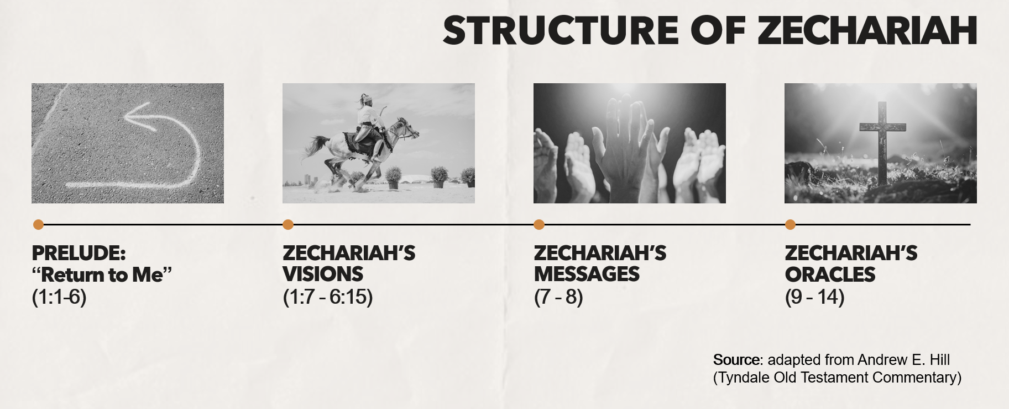
WORD
Notes:
Facilitators’ Notes:
This slide is used by the preachers for related sermons. For reference only.

Slide 6

The context of Zechariah 7-8
Almost two years have passed since Zechariah received the 8 night visions
He receives another word from the Lord (Zechariah 7:1).
This is the fourth year of Darius’ reign (December of 518 B.C.)*
Work on the temple resumed a little more than two years ago, but was not completed.
Notes:
Facilitators’ Notes
Time allocated: 3min
Read out – from slide 5 to 7. Take turns in the CG to read this out.
* “fourth day of the ninth month (Kislev)” – Kislev is around Nov-Dec period. Enduring Word Commentary writes: “On December 4, 518 B.C. a delegation came to Jerusalem with a question about fasting. At this point, the temple was somewhere around halfway completed.”

Slide 7
The context of Zechariah 7-8 (cont’d)
A delegation comes to Jerusalem to ask the priests whether they needed to continue fasting in the fifth month (Zechariah 7:3)
They had been fasting in the fifth month for many years to mourn the destruction of Solomon’s temple in the fifth month of 586 B.C.
So now that the temple was being rebuilt, they asked the priests: Is this fast still needed? It was a practical question.
They were about to get profoundly spiritual answer from God in Zechariah 7-8 …
Notes:
Facilitator Notes
Time allocated: 3min
Read out – from slide 5 to 7. Take turns in the CG to read this out.

Slide 8
Overview of Zechariah 7-8
It’s a long text so here is the big-picture structure of the two chapters, provided by Bryan Gregory.*
Scholars call this chiastic structure - a "mirrored" structure with a central focal point. That central focal point (e.g. the point in green below) is usually the most important.
A. A Question about Fasting (7: 1– 3)
  B. A Sermon against Hypocrisy (7: 4– 14)
    C. The Lord’s Promise to Transform Jerusalem (8: 1– 8)
  B' A Sermon on Sincere Obedience (8: 9– 17)
A' The Answer: Fasting Will Turn to Feasting (8: 18– 23)
*Bryan R. Gregory. Bryan Gregory - Longing for God in an Age of Discouragement (2017) (Kindle Location 2050). Kindle Edition.
Notes:
Facilitators’ Notes
Time allocated: 3min
Read out – from slide 5 to 7. Take turns in the CG to read this out.

Slide 9
Activity 1: Read & Discuss
Read Zechariah 7:4-14 and answer the following questions:
Does the LORD answer their question about fasting directly in verses 4-7? What is the deeper issue that the LORD is getting at?
The LORD instructed them to repent by acting with justice and mercy (Zech 7:8-10). What was their response (see Zech 7:11-14)? How might their response be a warning for us?
Notes:
Facilitators’ Notes
Time allocated: 15min
Answers are mostly found directly in the text itself
Try to give CG members (especially those who are more shy) an opportunity to answer
For question 2, give some time for people to share their personal reflections and applications

Slide 10

Question 1 Discussion Notes
No, the question is not answered directly. Rather, using rhetorical questions, the Lord exposed the lack of sincerity in the peoples’ fasting.
They were not fasting for the LORD but themselves (Zech 7:5)!
The people fasted without repenting; their fasting was just as self-indulgent as their eating (Zech 7:6)
While putting on a religious show, they were actually exploiting and oppressing one another! (Zech 7:9-10)
Their religion was a dead drudgery!
Why this matters: we too can fall into the trap of “dead” religious activity
Notes:
Facilitators’ Notes
Do not show this to the CG if there is no need to. This is not the “model” answer.
You can show this slide when the CG is stuck and unable to proceed.
Don’t show it too soon because that will kill all thinking and discussion.

Slide 11
Question 2 Discussion Notes
The people “refused to pay attention” (Zech 7:11a)
They “turned a stubborn shoulder” (Zech 7:11b) – just like a stubborn ox that will not allow a yoke on its neck.
They “stopped their ears” (Zech 7:11c) – like petulant children who refuse to listen
They “made their hearts diamond-hard” (Zech 7:12) – making their hearts unbreakably hard and calloused!
Why this matters: in what ways might we too have hardened our hearts to God by refusing to listen to Him?
Notes:
Facilitators’ Notes
Do not show this to the CG if there is no need to. This is not the “model” answer.
You can show this slide when the CG is stuck and unable to proceed.
Don’t show it too soon because that will kill all thinking and discussion.

Slide 12
Activity 2: Read & Discuss
Read Zechariah 8:1-8 and answer the following questions
How does the LORD promise to renew and transform Jerusalem?
Pause to think about what this means for you: do God’s promises toward Jerusalem resonate with you and give you hope and joy?
Notes:
Facilitators’ Notes
Time allocated: 15min
Answers are mostly found directly in the text itself
Try to give CG members (especially those who are more shy) an opportunity to answer
For question 2, give some time for people to share their personal reflections and applications

Slide 13
Question 3 Discussion Notes
Chapter 8 contains oracles from God (preceded by the phrase “thus says the LORD of hosts”) that show God is going to bring about glorious transformation! For instance:
  God has returned to Jerusalem and His presence will be with His people (Zech 8:3a)
  Jerusalem will be called a faithful city (given a new name!) when it previously was unfaithful (Zech 8:3b)
  The generations will experience blessing and peace - note that children and elderly are mentioned (Zech 8:4-5)
Why this matters: When we truly recognise how good God is and how wonderful His promises are, this frees us for joyful obedience unto Him!
Notes:
Facilitators’ Notes
Do not show this to the CG if there is no need to. This is not the “model” answer.
You can show this slide when the CG is stuck and unable to proceed.
Don’t show it too soon because that will kill all thinking and discussion.

Slide 14
Activity 3: Read & Discuss
Read Zechariah 8:14-17 and answer the following questions
The LORD’s promise comes with a command and instruction. What does the LORD call his people to do? Read Zech 8:14-17 together with Zechariah 7:9-10 (the commands are similar).
In what ways have you seen someone live out the King’s justice and mercy? How might you also live this out?
Notes:
Facilitators’ Notes
Time allocated: 15min
Answers are mostly found directly in the text itself
Try to give CG members (especially those who are more shy) an opportunity to answer
For question 6, give some time for people to share their personal reflections and applications. If they can't think of anything, can read the quote by Keller on slide 15 and ask them for their thoughts on this.

Slide 15
Questions 5 and 6 Discussion Notes
God commanded His people to practise:
  Truthfulness in interpersonal relationships and in the justice system (Zech 8:16)
  Love, mercy and kindness toward one another, not doing others harm (Zech 8:17a, Zech 7:9). In particular they are to demonstrate justice and mercy to the poor and marginalized in society – the widow, fatherless and the sojourner/foreigner (Zech 7:10).
Read the quote from Rev Dr Timothy Keller’s Generous Justice in the next slide and reflect on how we can live it out.
Notes:
Facilitators’ Notes
Do not show this to the CG if there is no need to. This is not the “model” answer.
You can show this slide when the CG is stuck and unable to proceed.
Don’t show it too soon because that will kill all thinking and discussion.

Slide 16

Many believe that the job of the church is not to do justice at all, but to preach the Word, to evangelize and build up believers. But if it is true that justice and mercy to the poor are the inevitable signs of justifying faith, it is hard to believe that the church is not to reflect this duty corporately in some way. And as soon as you get involved in the lives of people—in evangelism as well as spiritual nurture—you will come upon people with practical needs. You can’t love people in word only (cf. 1 John 3:16–17) … without meeting practical and material needs through deeds.
- Keller, Timothy. Generous Justice: How God's Grace Makes Us Just (Law, Justice and Power) (p. 135). John Murray Press. Kindle Edition.
Notes:
Facilitators’ Notes:
- Can invite a member to read the quote out

Slide 17
Activity 4: Read & Discuss
Read Zechariah 8:20-23 and answer the following question
When God’s people obey Him wholeheartedly in loving relationship, we will have a tremendous influence and impact on the nations of the world! What is this influence, according to Zechariah 8:20-23?
Notes:
Facilitators’ Notes
Time allocated: 10min
Answers are mostly found directly in the text itself
Try to give CG members (especially those who are more shy) an opportunity to answer

Slide 18
Question 7 Discussion Notes
The nations of the world will be drawn to seek God (Zech 7:20)
They will have an urgency and joy in seeking GOD - they will say “let us go at once” (Zech 7:21)
Even the “strong nations” will come – all will humble themselves before the true King (Zech 7:22)
The presence of God with us will be what draws non-believers to Him (“let us go with you, for we have heard that God is with you”, Zech 7:23)
Why this matters: our obedience to God has a missional and eternal impact! God will use us to bring about the joyful obedience of the nations!
Notes:
Facilitators’ Notes
Do not show this to the CG if there is no need to. This is not the “model” answer.
You can show this slide when the CG is stuck and unable to proceed.
Don’t show it too soon because that will kill all thinking and discussion.

Slide 19

Reflect and Pray Together
Share with one another the key thing that God spoke to you about in Zechariah 7-8.
Pray for one another, that we may be cleansed from dead religious drudgery and freed for joyful obedience to the Lord!
Notes:
Facilitators’ Notes
Time allocated: 20min
Take the time to share and process so that the study is not just informational but transformational!

Slide 20

Next Steps
Pray for non-Christians you know to be drawn to seek the Lord of Hosts (Zech 8:22), and that you might be a witness to them!
Pray for a nation on the world that God is laying upon your heart. Pray that God's Spirit would sweep through that nation and draw many to Himself.
Notes:
Facilitators’ Notes
Time allocated: 20min
Take the time to share and process so that the study is not just informational but transformational!

Slide 21

Additional Resources for Further Study
Gregory, Bryan R. Longing for God in an age of discouragement: the Gospel according to Zechariah. P & R Publ., 2010.
Anthony R. Petterson, ed. David W. Baker and Gordon J. Wenham, vol. 25, Apollos Old Testament Commentary (Nottingham, England; Downers Grove, IL: Apollos; InterVarsity Press, 2015)
Andrew E. Hill, ed. David G. Firth, vol. 28, Tyndale Old Testament Commentaries (Nottingham, England: Inter-Varsity Press, 2012)
Mark J. Boda, The NIV Application Commentary (Grand Rapids, MI: Zondervan Publishing House, 2004)
Notes:
Facilitators’ Notes
Share only to those who are keen.

