Slide 1
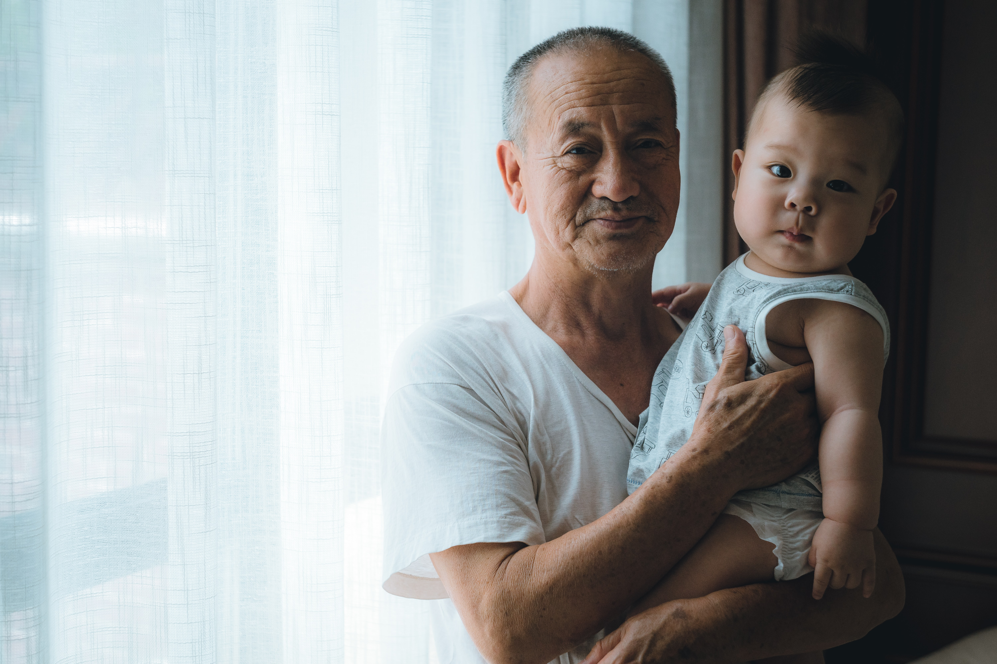
DISCIPLE THE GENERATIONS
Post sermon CG discussion
for week 24th Jan – 30th Jan

Slide 2

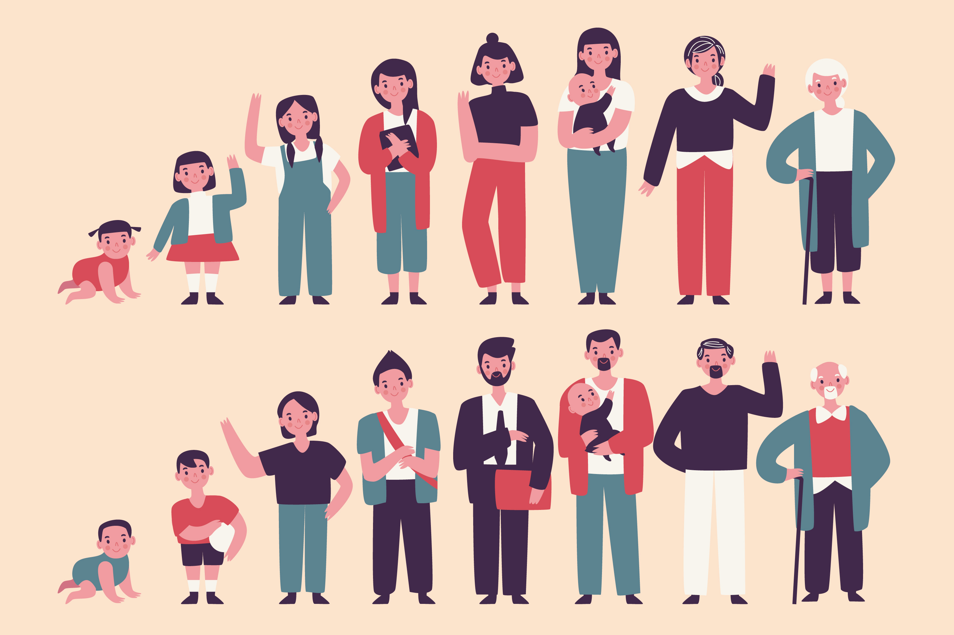
Ice Breaker
Suggested activity : If you could choose a generation to be in - Youth, Young Adult, Middle, older adult - which would you choose? Why?

Slide 3
Overview

Slide 4
The Faith exploits are the practical expression of our mission statement. It begins with the end in mind, which is to Disciple the nations. The second faith exploit is to Disciple Singapore. The most immediate context is to Disciple the Generations.
Discipling the Generations is about two things – Passing on GOD’s blessing and connecting through relating.

Slide 5
Discussion Questions

Slide 6
God desires for His goodness to be passed on from generation to generation. This is not merely passing on information about Him, but our own personal encounters and journey with Him. Was there a time (or many times) when GOD was “real” to you? What was the encounter about? Share one such story.
We are created us in His image. Just as our GOD is a personal GOD in relationship as the Triune GOD, so likewise, we are created for meaningful connections and bonding. What are some ways the CG can deepen those bonds especially in the midst of the pandemic?

