Slide 1
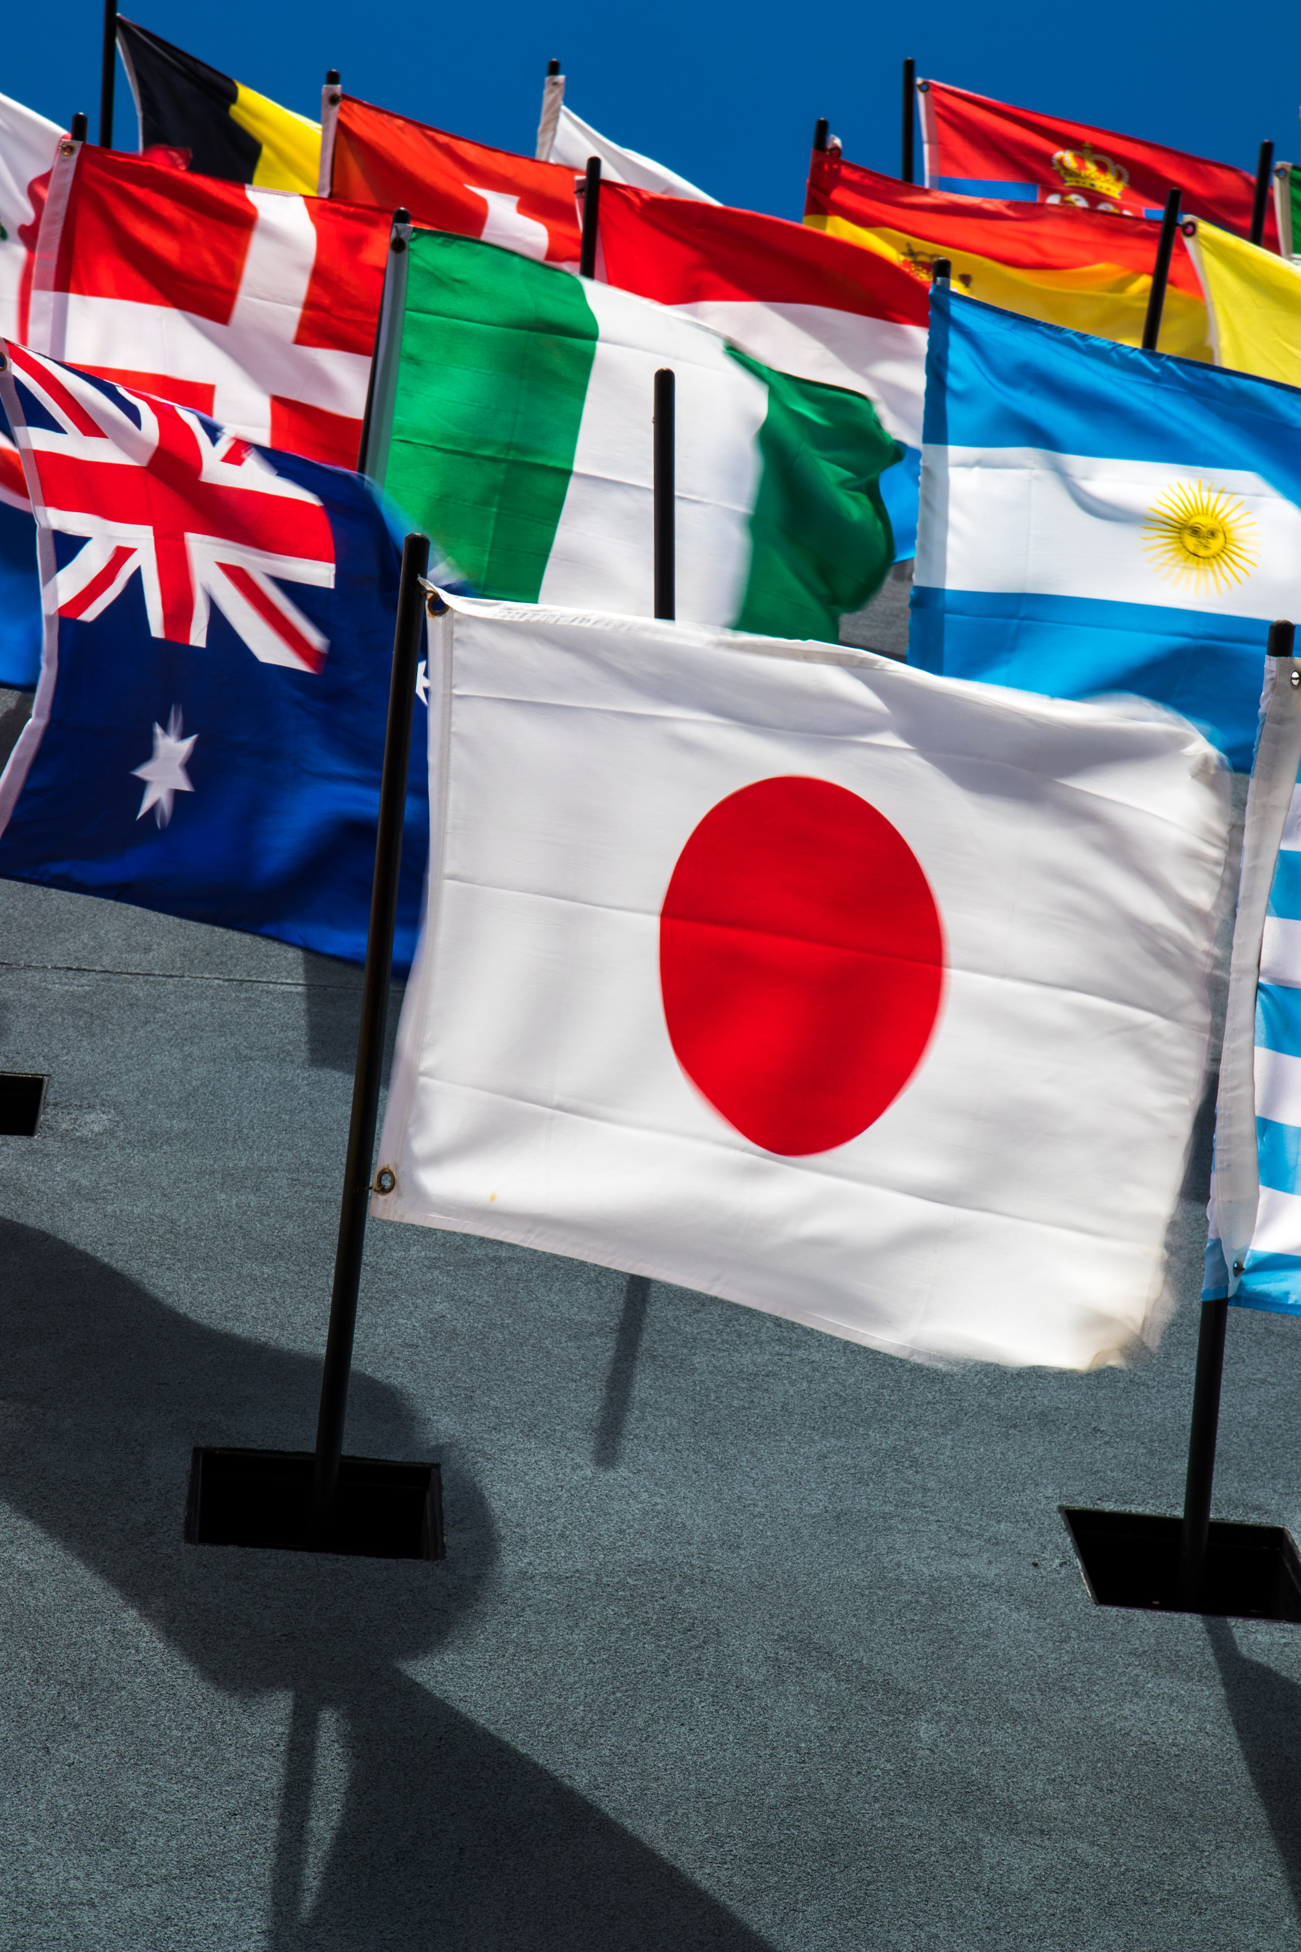
DISCIPLE THE
NATIONS
Post sermon CG discussion
for week 10th Jan – 16th Jan

Slide 2

Ice Breaker
Suggested activity : Identify the flags of the world.
https://world-geography-games.com/en/flags_world.html

Slide 3
Discussion Questions

Slide 4
1a. Share your experiences on your past mission trip(s) . What did God show / teach you?
OR
1b. What has prevented you from embarking on a short-term mission trip in the past?
2. Share which part of Matthew 28:18 – 20 speaks to you the most and why.
¹⁸ And Jesus came and said to them, “All authority in heaven and on earth has been given to me. ¹⁹ Go therefore and make disciples of all nations, baptizing them in the name of the Father and of the Son and of the Holy Spirit, ²⁰ teaching them to observe all that I have commanded you. And behold, I am with you always, to the end of the age.”
3. Which part of last week’s sermon spoke to you or challenged you and why?

Slide 5

4a. On a scale 1 to 10 (1 = not committed at all; 10 = very committed), how committed are you to joining the mission lunch time prayer time? (What makes it challenging for you to commit to this?)
10 = very committed
1 = Not committed

Slide 6
OR
4b. As a CG, on a scale of 1 to 10 (1 = not committed at all; 10 = very committed), how committed are you to being actively involved with mission – praying for a specific nation and planning a short-term mission trip (even before borders reopen)? Discuss this as a CG.
10 = very committed
1 = Not committed

